Slide 1
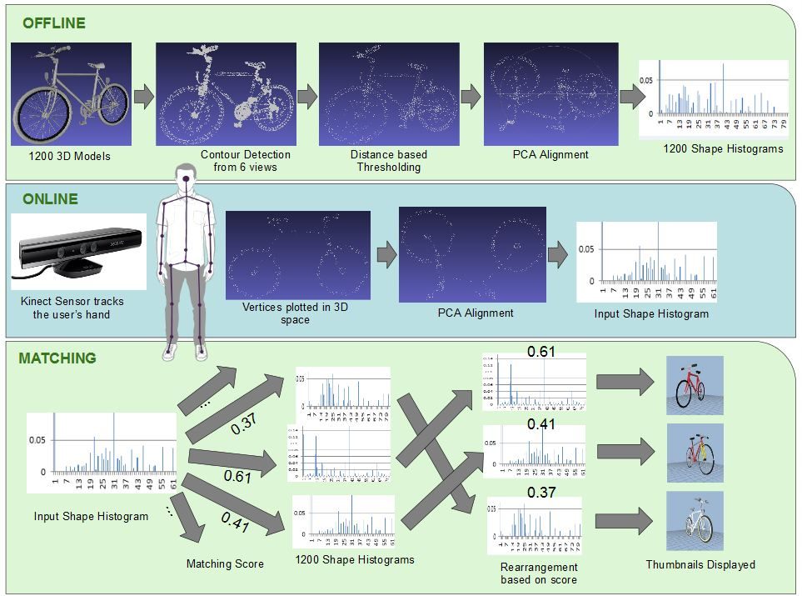
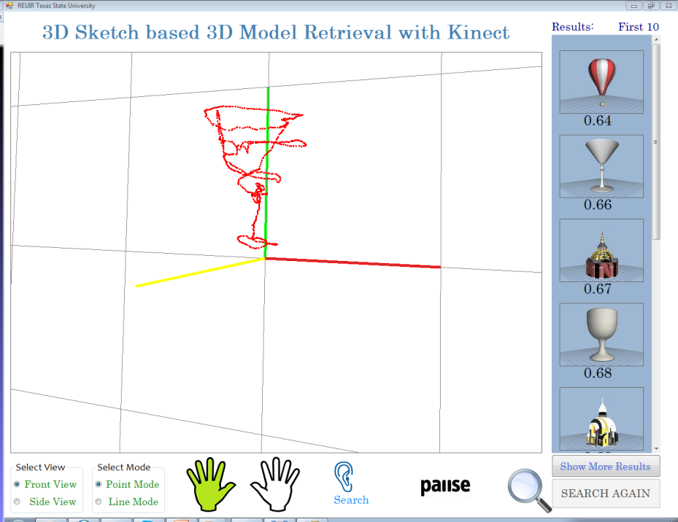
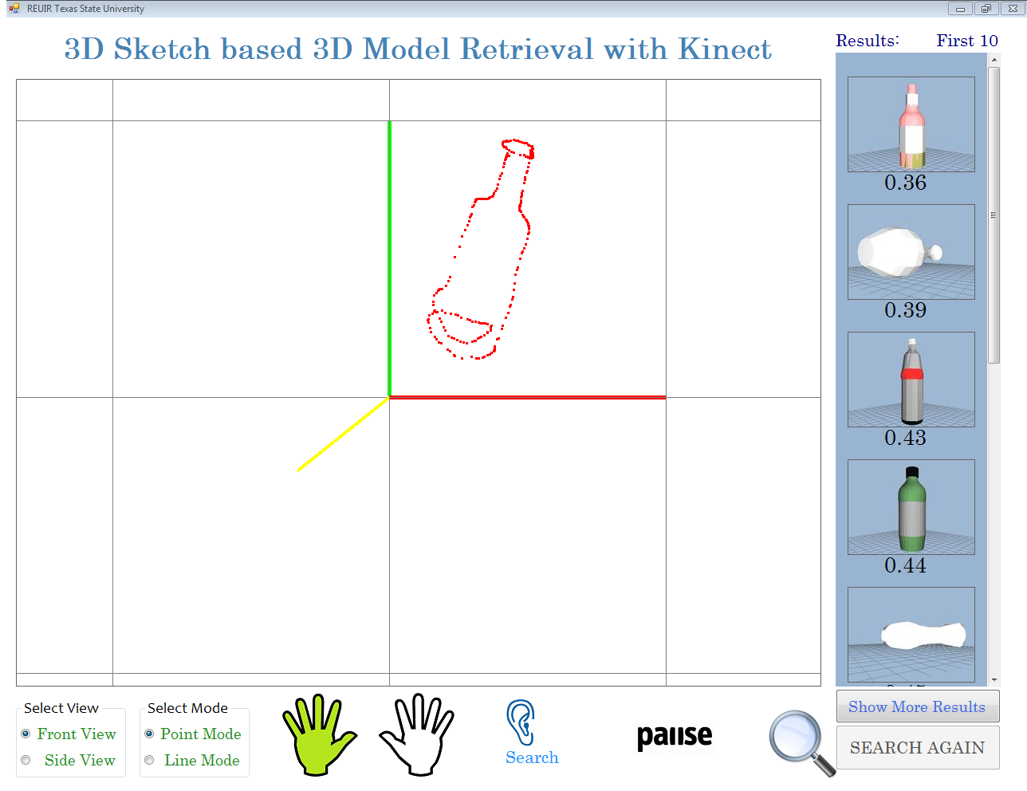
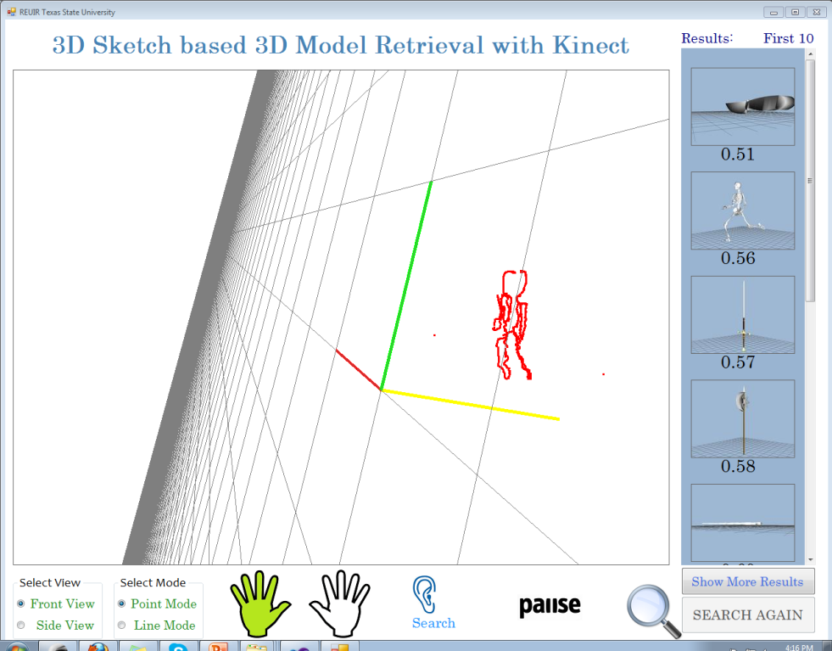
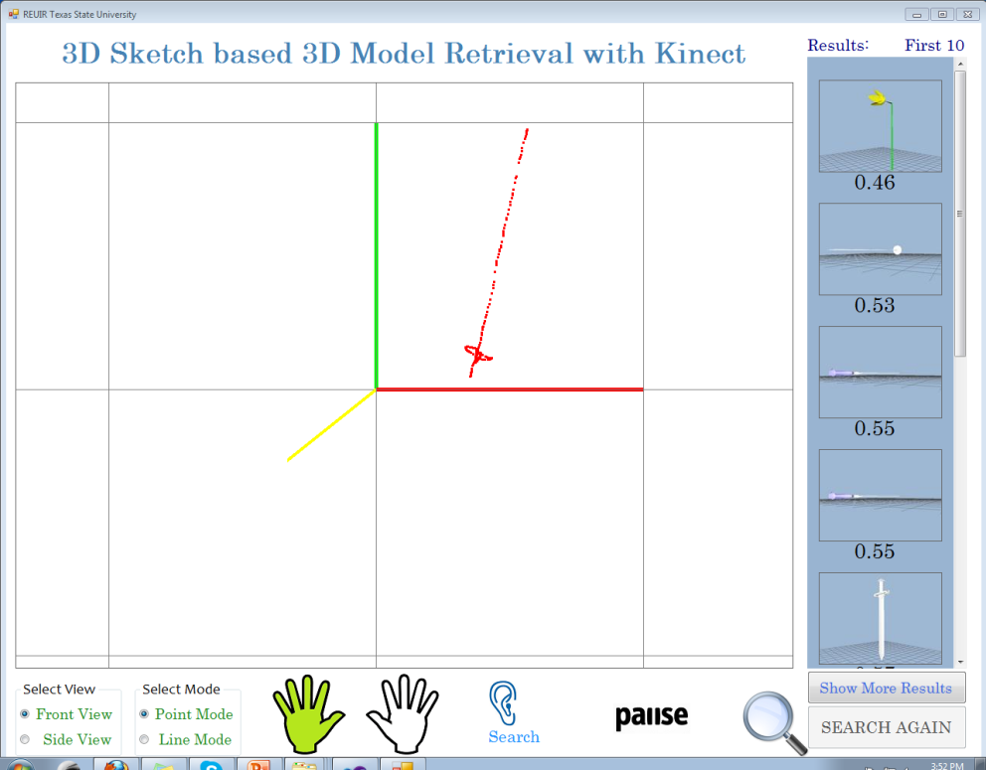
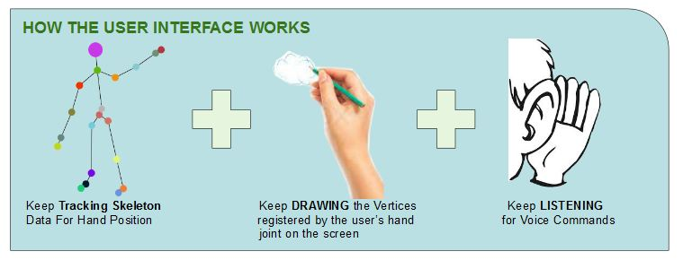
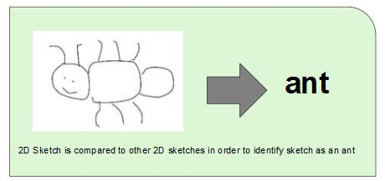
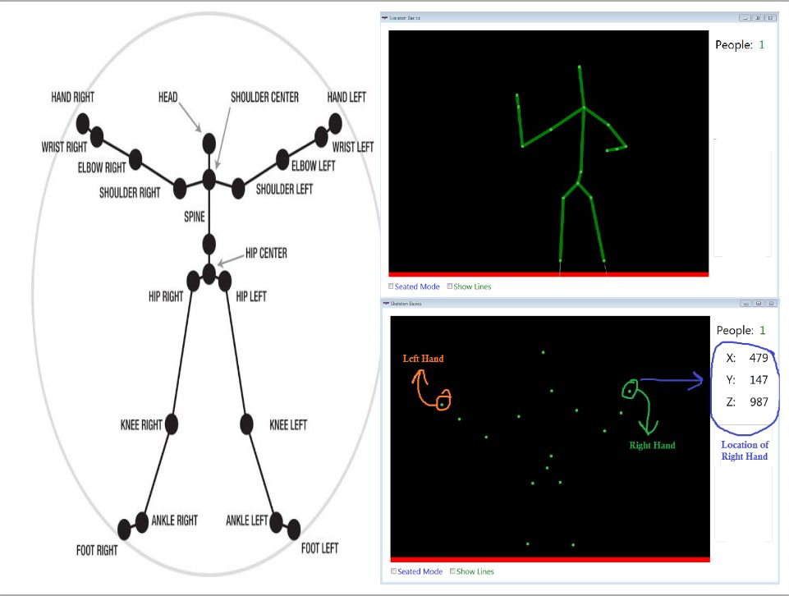
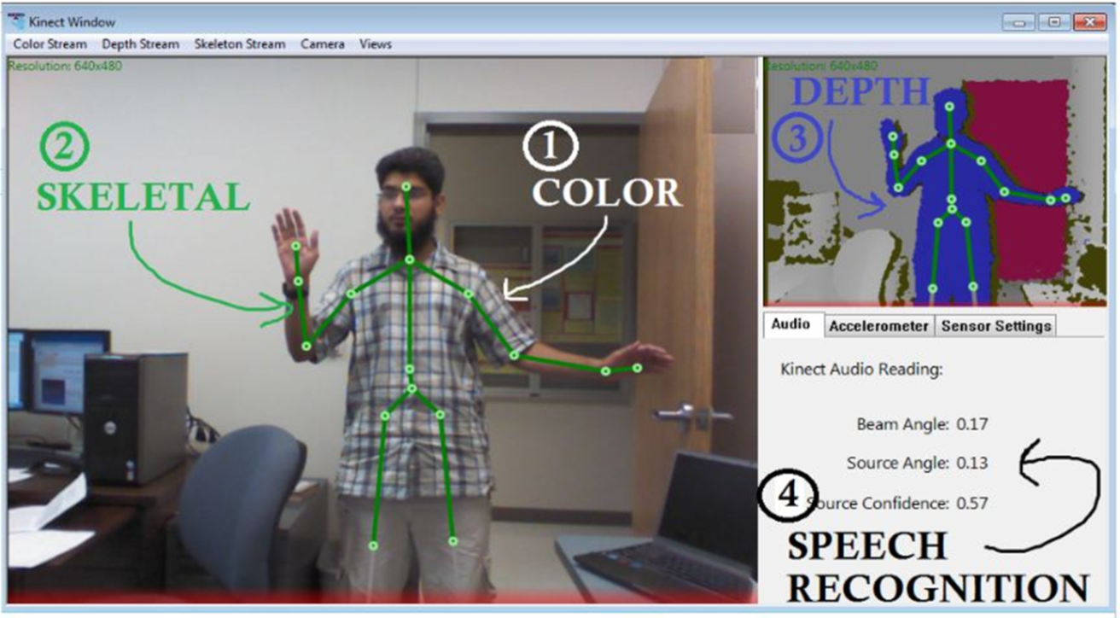
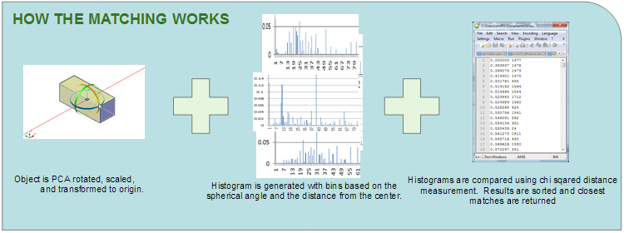
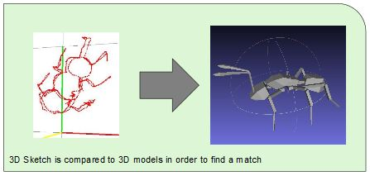
3D Sketch-based 3D Model Retrieval With Kinect
Natacha Feola¹, Azeem Ghumman², Scott Forster³, Dr. Yijuan Lu⁴
¹ Department of Computer Science, University of Kentucky, KY, USA
² Department of Electronics Engineering, Ghulam Ishaq Khan Institute (GIKI), Pakistan
³Department of Computer Engineering, University of Maryland, Baltimore County (UMBC), MD, USA
⁴Department of Computer Science, Texas State University, TX, USA
Introduction
Framework
Demo System
Experiments & Results
We propose a novel approach to allow people to freely draw a 3D sketch in a virtual 3D space.
The program matches user generated 3D sketches with models in a 3D database. Our system utilizes a Kinect sensor to record a user’s hand position over time. The point field generated is then compared to objects in a 3D database and likely matches are displayed.
Our project shows great promise in the field of Human Computer Interaction for it’s intuitive interface and fast response time.
Create 3D sketch database
Models are sketch views of Princeton Shape Benchmark
All models chosen are from the SHREC 2012 dataset which consists of 1200 models and 60 classes
We also created the largest 3D sketch database by collecting 3D models from ESB CAD, CCCC, Bonn Archi-tecture, Google Warehouse, Watertight 3D, NIST, etc.
Understanding of Kinect sensor
Capabilities outlined
Point field capture program created
Feature chosen for 3D shape matching
Criteria: Speed, accuracy, and ease of implementation
Shape histogram matching program created
Parts integrated into demo system
Fast real-time searching
A very powerful and intuitive user interface equipped with gestures and voice recognition to facilitate 3D sketching.
To match the object it was experimentally found that 19 sectors and 6 shells yield the best results.
Problem
There does not yet exist a method to capture a 3D sketch in virtual 3D space.
Current sketch based matching only uses 2D information.
User is constrained to drawing on a surface.
How do we allow user to freehand sketch in the air?
Can we incorporate 3D matching to improve retrieval accuracy?
Tested our system with multiple sample sketches and matched to SHREC 2012 models.
Good results with simple shapes & sketches.
Excellent search speed.
Conclusions & Future Work
Successful development of 3D sketching software, implementation of 3D object retrieval based on 3D sketch, and development of a real-time 3D sketch based retrieval demo system.
Plans to improve:
Implement machine learning algorithm to improve matching.
Explore gesture recognition to allow for easier sketching.
Acknowledgements
This research is supported by the NSF REU Program and Texas State University.
References
[1] Eitz M., Hays J., Alexa M.: How do Humans Sketch Objects? ACM Trans. Graph. 31, 4 (2012). [2] Li, B., Schreck, T., Godil, A., Alexa, M., Boubekeur, T., Bustos, B., & Yoon, S. M. SHREC'12 Track: Sketch-based 3D Shape Retrieval. In Proceedings of the 5th Eurographics conference on 3D Object Retrieval (pp. 109-118). Eurographics Association. (2012).
[3] Shilane, P., Min, P., Kazhdan, M., & Funkhouser, T. (2004, June). The princeton shape benchmark. In Shape Modeling Applications, 2004. Proceedings (pp. 167-178).

