Slide 1
Domain Specific Deep Web Discovery and Cataloging
Chelsea Hicks
Matthew Scheffer

Slide 2
Problem
The benefit of extracting information from the deep web is that there are 400-550 times more the information than the normal surface web (1).
The manual process of finding Deep Web sites and entering queries is not scalable, especially due to the growing size of Deep Web (2).

Slide 3
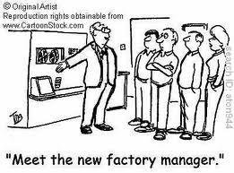
Our Project
To find an automated way to discover and catalog the deep web that isn’t labor intensive and scalable to multiple domains.

Slide 4
Previous Works That Are Closely Related
Babosa et al. have a search engine called Deep Peep, which searches through multiple deep web domains.
Pros:
Uses hidden-web crawler, a focused-crawler for sparse concept on the web, clustering for organizing a large set of forms, and learning-based approach to automatically extract labels.
Cons:
Some inaccuracy found, hotel websites can be found in the airfare domain.
No quality information given.

Slide 5
Previous Works That Are Closely Related Continued
Ngu et al. use regular expressions to compare result pages in scientific domains, and can handle indirection pages.
Pros:
Handles Indirection Pages
Contains Query Enumeration
Cons:
Not Generalized
Due to Query Enumeration, Must be edited a lot for a new domain.
New permutation methods must be created for each domain, which can be troublesome.
Must discover different types of queries.

Slide 6
SCD – What is it?
SCD – Stands for Service Class Description.
The SCD is an XML file that has types which are defined by regular expressions.
Each SCD defines types for a particular domain.
These types are compared to the source code of a website.
Types have to be created manually, and tested to verify the regular expression is working.

Slide 7
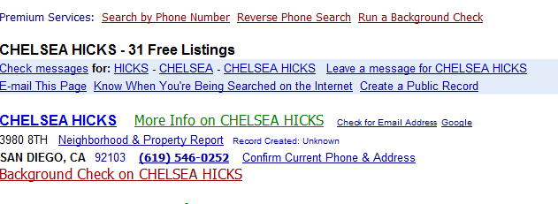
SCD – What it looks like
<serviceclass name="PEOPLE">
</type>
<type name="listing" type="string" pattern="([0-9]+)([\s]+)([Ff]{1})([Rr]{1})([Ee]{1})([Ee]{1})([\s]+)([Ll]{1})([Ii]{1})([Ss]{1})([Tt]{1})([Ii]{1})([Nn]{1})([Gg]{1})" />
</types>
</serviceclass>

Slide 8
Scope of the Project
Main goal: discovering and cataloguing via automatic query submission and checking of a result page.
Use Selenium for automatic query submission
Results page filtered by a SCD using regular expressions
Define some domain specific rules to facilitate query submission: e.g. domain search term, anchor attributes, no of input fields/textboxes.

Slide 9
Project Overview

Slide 10
Bing Crawler Process
Input the query, set the number of results and retrieve them,
Go through each website and see if they pass the initial verification test:
Not be in the cache
Have a certain number of input fields
Contain a certain amount of keywords
If it passes, store in the cache and an output file. Otherwise, go to the next URL.

Slide 11
Bing Crawler vs Traditional Crawler
The original crawler requires an extra process to get the base url.
The crawler grabbed too many URLs, a lot of advertisements, unrelated sites, etcetera. Bing only gives us the 10 results per page, no advertisements.
Bing uses much less time than the traditional crawler

Slide 12
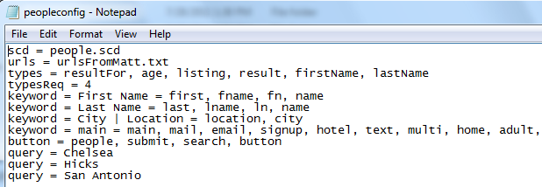
Configuration File For Selenium Querier

Slide 13
Generating Atomic Query
Anchor Attributes – The attributes in the domain that are always there.
Atomic Query – The query to be used for that particular domain.
Find the anchor attributes in one of three ways.

Slide 14
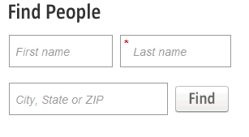
Anchor Attributes

Slide 15
Submitting the Query
After finding the anchor attributes, submit the atomic query.
Atomic Query: Example data that can be used on any website in that domain.
The actual submission can be tricky.

Slide 16
Comparing the Result Page
The result page can be three pages:
The correct result page
An error page
The entry page where submission has failed.
The results are compared to the SCD.
The urls are stored in separate places depending on the comparison with the SCD

Slide 17
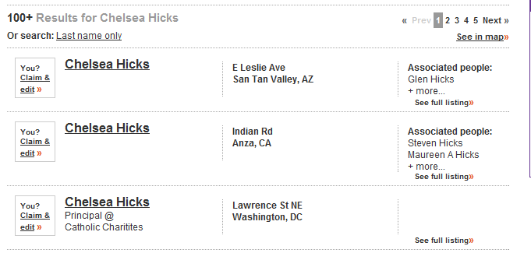
Results for People Domain

Slide 18
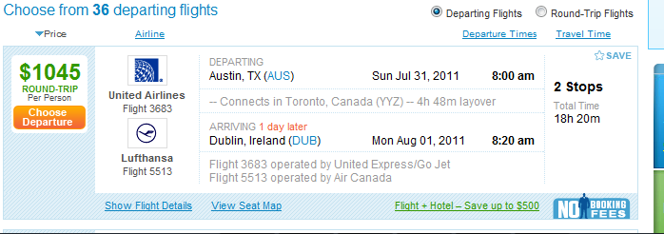
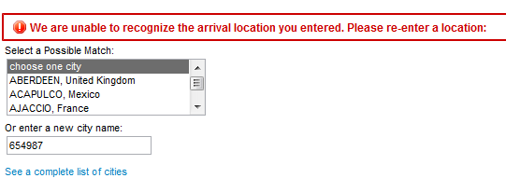
Results for Airfare Domain

Slide 19
Our Results
Dataset | True Negative | True Positive | True Positive with Manual | False Negative | False Positive | Recall* | Precision*
Flight | 15 | 32 | 45 | 3 | 0 | 93.75% | 93.75%
People | 39 | 5 | 11 | 5 | 1 | 73.33% | 68.75%

Slide 20
Future Work
Implement information extraction
Automation of SCD generation
Implement query enumeration
Implement machine learning
Support different input types
Implement clustering

Slide 21
Demo

Slide 22
Conclusion
Automation of query submission for two domains.
Implemented a Deep Web crawler.
Implemented a SCD comparison for result pages.
Set the stage for next years REU program which will be continuing our work.

Slide 23
References
Querying Capability Modeling and Construction of Deep Web Sources by Liangcai Shu, Weiyi Meng, Hai He, and Clement Yu
Understanding Deep Web Search Interfaces: A Survey by Ritu Khare, Yuan An, II-Yeol Song

