Slide 2
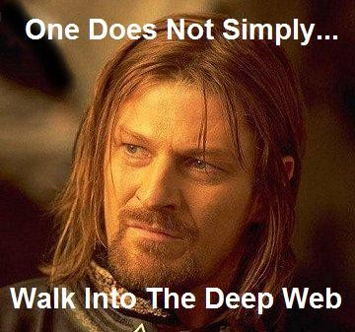
Current Search Technology for Deep Web
Currently, Google and other search engine technologies only search the surface web, which only accounts for a fraction of the data online.
In order to search the Deep Web, we must find a way to index the deeper information on the internet.
The current process of manually entering queries to known Deep web sites is not scalable due to the exponential growth of the internet.

Slide 3
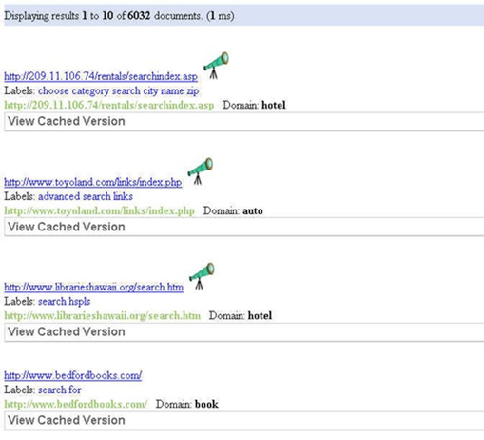
Related Work : Deep Peep
A previous program, called “Deep Peep”, was developed at the University of Utah.
This program would crawl the web and catalogue deep web site by indexing its entry points (query forms)
Upon user query, Deep Peep would return a number of related query forms in ranked order, so someone looking for a hotel, for example, would be presented with several hotel booking sites.
Deep Peep’s limitations were that:
The user had to submit multiple redundant queries to all
the sites to get data from deep web
It assumes that the entry point completely characterizes
data in deep web.

Slide 4
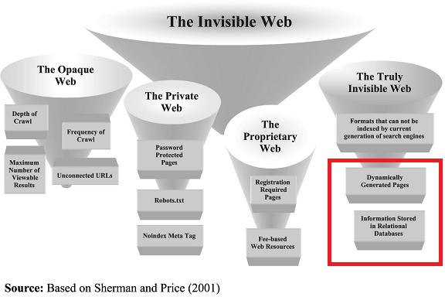
Background
Last summer, REU students working for Dr. Ngu designed a service that would crawl the internet to find domain-specific Deep web sites such as airfare, hotels, and people-finders.
This generalized Deep web discovery framework can achieve high precision by leveraging Service Class Description (SCD) for verifying result page one it is successfully submitted.

Slide 5
Generalized Deep Web Discovery Framework

Slide 6
SCD
An SCD is a “service class description”, an XML file used to describe what a domain specific web page should contain.
It uses regular expressions to indicate the expected content of the service site.
For example, the result page of a flight booking site would be expected to contain terms such as “departure date” and the result page would have time pattern such as 09:45 AM .

Slide 7
Example of an SCD
The “time” example type will annotate the arrival and departure times of a site without grabbing flight number or price.
<type name="time" type="string" pattern="([0-9]{1,2})([:]{1})([0-9]{2})" />

Slide 8
Our Goal
Upon successful submission of query to a Deep web site, extract all relevant site information (functional and non-functional) and create a catalog of the discovered Deep web site which will facilitates future automatic query to that site
Provide a domain specific deep web exploration service that can query across multiple Deep web sites of a particular domain and dynamically aggregate the result from multiple sites
Achieve high success rate in the automatic query submission process

Slide 9
Contributions
We have created a table extraction method that will extract data dynamically from Deep web sites that use tables to display their information.
We have created a list extraction method that extracts a repeated pattern of data and filters/sorts the information.
We have created a local front end applet that facilitates query across multiple sites of the same domain and catalogue discovered site information.
We have made automatic submission not only faster, but more functional than previously, as well as adding functionality to make the process less likely to fail.

Slide 10
Automated Submission Challenges
Websites have no set structure and the input boxes and buttons that we need to identify can, and usually are, named almost randomly.
Often websites use an indirection/loading page in-between the input page and the results page and It is difficult to recognize when you have submitted successfully and have not just reached an error page.
Complex websites sometimes use javascript and flash for their input interfaces which is difficult if not impossible to parse.
Sometimes it is possible to find the majority of the input boxes you are looking for but one is unable to be matched.
Scraping the webpage and trying to identify input boxes is very slow and CPU intensive.

Slide 11
Our Approach to Automated Submission
For each domain, we need to identify the anchor terms which corresponds with the minimum number of required form parameters that must be bound before the query can be submitted, for people finder domain, these are first name, last name, and location.
For each anchor term in each domain, our automated submission technique relies on identifying a cluster of partial match terms associated with an anchor term. These terms are manually created by visiting a small number of high quality domain specific web sites
Once the entry point of a Deep webpage is loaded, we extract all available forms on that page and try to find one that contains all of the required form parameters that match based on each elements ID and name with our anchor terms.
If we are able to match up all of the anchor terms with the extracted form parameters except for one, we brute force all of the remaining form parameters in that form with the query data and test to see if we can reach a results page.
Once we have reached the result page we catalog the names and id’s of the elements that we used to submit the query such that the next time around we can go directly to those elements.

Slide 12
Example Forms and Configuration File
Notes:
Need ti use a people domain example.

Slide 13
Extraction Challenges
Result pages have no set structure. Web designers attempt to create a visually appealing page which is often very complex and difficult to be machine readable.
Even if a group of websites use tables they are all configured differently. Many websites have several levels of nested tables.
Data in a result page can be named arbitrarily which makes it difficult to identify that two columns from different web sites carry the same information.
It is difficult to discern the relevant data from all of the other text on a webpage especially when you try to grab data beyond just the generic data provided by most websites.
Often times some information is available for certain entries but not for others causing alignment issues during extraction.
There are no obvious labeling of data in the result page.

Slide 14
Extraction of Information
Our extraction technique is based on three approaches.
Table extractor – Our table extractor exploits the fact that Deep web sites do use a table to display their results data. We parse this table and retrieve its header elements and the data under the header elements.
RDE (Repeated Data Extractor) – Instead of being designed for a specific organizational type it exploits that results pages will somewhere have repeated elements that contain the desired information. First we find the section with the repeated elements and then try to extract just the relevant information.
Pattern Based Extractor – this is a fall back extraction method (flight only at the moment) that leverages SCD to extract all matching data without being concerned about html structure. Relies on data being in neighboring code.
After running these methods we try to discover what the data is by pattern matching it with our domain specific SCDs. Uncategorized information is left with the title extracted from the website. This gives our results greater precision and eliminates unwanted information.
Notes:
Need to re-write the last two point.

Slide 15
Table Extractor
The extractor begins by grabbing all of the tables on the results webpage.
If one of the tables has multiple table headers and rows, we attempt to extract information from that. If we are unsuccessful we move onto other tables that meet the same criteria.
If a table that contains data that we want to extract is identified, the table headers are first extracted and cataloged.
We then iterate through the table rows extracting each <td> item and put the data under the respective extracted header.
Once we completed extracting all row data, we reconcile the column name of each extracted table with the anchor terms defined for each domain to facilitate aggregation of data from multiple sites. This is achieved by checking the SCD type of the extracted data. If there is a matching type, we will replace the column name with our designated “anchor term”.

Slide 16
Table Extractor Pseudo code
Our technique starts by parsing the results page looking for all of the <table> tags within.
Once we have found a table we try to look for its top row with table header data. If this data is found we simply take each header and create a column for it in our extraction data structure. If we can not find a header we simply take the results from the first row and use that as our header values.
We iterate through the remaining rows of the table and extract each data element and attempt to put it in the appropriate row based on its position.
Once all of the data has been extracted we use our pattern matching technique to try to identify the data in each column. If the data matches one of the domain specifically defined patterns, we change the header name to a common name we have chosen.
If we notice one of the values in a column is unlike the others, for example, in a price column we see Sold Out or Not Available, we simply replace the text with an empty block.

Slide 17
Table Example

Slide 18
Table Code Example

Slide 19
Repeated Data Extractor
We start by going through the website looking for a parent element that has a large number of child elements sharing a common class name or id.
Once the parent containing the largest number of similarly named elements is identified we go through each sub elements children extracting the display text and values.
These extracted values are added into our catalog data structure with the headers being the class name or id of the extracted element.
We run the extracted data through several tests to try to strip out as much irrelevant information as we can while still maintaining useful data.
Once all of the data has been filtered we leverage SCD as show in the table extractor to try to label the underlying data.

Slide 20
Repeated Data Extractor Pseudo code
Recursively traverse the results page attempting to locate every web element that has more than 4 sub elements sharing the same classname or ID that also make up atleast 75% of the total elements of the parent.
Out of the found elements, the parent element with the largest number of children is our extraction candidate.
Recursively iterate through this element’s children extracting the text values and matching them up with their given classname or ID.
After all of the text is extracted we attempt to filter out irrelevant information by throwing out groups of elements that are larger or smaller in number than the rest of our extracted elements.
Next we filter out all element groups that contain the same text data over and over. This technique has the possibility of filtering out things such as name because unless they have a different middle name, all of the results will be the same. We overcome this by keeping anything that matches our query.
Once we have finished filtering the results we use our pattern matching technique to identify known data types and change their header to our anchor term.

Slide 21
Additional Information Extraction
In addition to extracting the requested information from the results page we also save and store the following site quality information.
Connection Information (URL,Protocol,html headers,wait time)
Input Boxes classnames/ids
Submit button classname/id
Results headings classnames/ids
This information is stored such that in the future it might be possible to create a submission technique that doesn’t even have to visit/scrape the web page at all.
Currently we use the Input Boxes and Submit information such that we don’t have to try to find partial matches every time.
Notes:
What do you mean by the last point?

Slide 22
Repeated Data Example

Slide 23
Repeated Data Code

Slide 24
Pattern-based Extractor
Uses predefined regular expressions for expected values to identify data on a results page (for flight, expected values would include flight no. and price).
Once these data have been found, they are annotated with tags so that they can be easily referred to and/or retrieved later.
The data are extracted one at a time until an instance of each has occurred.
The order in which they were found is recorded for extracting the rest of the data. That way, if there is one row that is missing a datum, the extractor will recognize this and account for it.
This method is very effective at grabbing the required information precisely, however it is incapable of extracting data types that we are unfamiliar with.

Slide 25
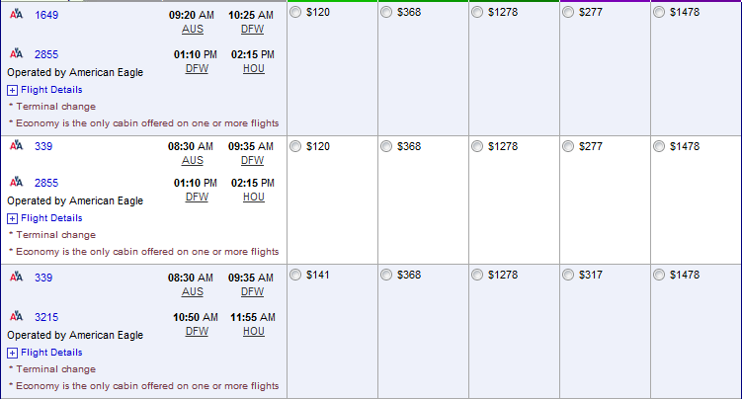
In the above example, the annotated extractor would recognize that even though the row with flight number 3215 does not contain any prices, it is in fact a complete row. It will fill any cell that would normally contain a price with an empty string to avoid misalignment of data.

Slide 26
Data Recognition
Regardless of the extraction method, the extracted data is processed here.
This program will use regular expressions of data types and small clusters of terms to identify data headers. Data headers that are recognized are presented using the existing cluster keyword.
If the header name is not recognized, the data is analyzed and if the data matches the data requirements of a known cluster, the new header is added to that cluster for future recognition.
If the header name is not recognized and the data matches a regular expression but the data types that they match are not associated with a know cluster, then a cluster is created with the header name as the keyword
Any misalignments in the table are also corrected by the program by inserting empty strings into cells until data is aligned.
What if a header is not recognized and the data does not match an SCD pattern? In the future, work could be done in the area of automatic SCD pattern generation. This would require large sample sizes but would enable an expansion of recognized data types.

Slide 27
Future Work
We are unable to submit to a large amount of websites due to not supporting drop down boxes and multi value text boxes. Once these are implemented we should be able to accurately submit to many more sites.
Our extraction methods, while very generic, need to a little more work to be tweaked to support the small differences between websites.
Selenium currently does not support many javascript functions that modern browsers support. Once selenium catches up with the standards set by Chrome, Firefox, and Internet Explorer we will have a better chance at submitting to more websites with redirection pages and scripts.

Slide 28
Thanks! :D

