Slide 1
Earth Mover’s Web Service Searcher E.M.W.S.S.
Scott julian
Xiaojie Jiang
Dr. Ngu

Slide 2
What is a web service?
Web services are modular, self-describing, and loosely coupled software components that can be located and used over the Internet
A web service is defined by a WSDL file
The WSDL (Web Service Description Language) standard specifies the interface of a service in terms of operations and messages
Because of their reusability and platform independence, using web services in applications is becoming a widely popular and successful way of creating cloud based applications
Finding relevant Web services for creating useful and robust applications is becoming an emergent and challenging research problem

Slide 3
WSDL file
Glorified XML (eXtensible Markup Language)
A document that describes:
what a service does
where to invoke it
how to invoke it
WSDL description is divided into two parts:
Abstract description
type, messages, operations, port
Concrete description
transport protocol binding, endpoint, service name

Slide 4
WSDL FILE
<message name="getRateRequest">
<part name="country1" type="xsd:string"/>
<part name="country2" type="xsd:string"/>
</message>
<message name="getRateResponse">
<part name="Result" type="xsd:float"/>
</message>
<portType name="CurrencyExchangePortType">
<operation name="getRate">
<input message="tns:getRateRequest" />
<output message="tns:getRateResponse" />
</operation>
</portType>
<binding name="CurrencyExchangeBinding" type="tns:CurrencyExchangePortType">
<soap:binding style="rpc" transport="http://schemas.xmlsoap.org/soap/http"/>
<operation name="getRate"> … </operation>
</binding>
<service name="CurrencyExchangeService">
<port name="CurrencyExchangePort"binding="tns:CurrencyExchangeBinding">
<soap:address location="http://services.xmethods.net:80/soap"/>
Abstract

Slide 5
Problem – finding web services
Increasing number of available web services
(e.g. programmableweb.com)
Finding relevant web services is becoming more important and challenging because of the increase of web services
Searching for a web service has moved from repositories, like UDDI, to web based search engines
(e.g. seekda.com)

Slide 6
Problem – search engines
Current web based search engines are designed for searching through webpages that is unstructured or semi-structure like html page
Current web based search engines are not designed to take advantage of the structure of WSDL file for finding web services
Typically Vector Space Model is used to compute the similarity between keywords in the query against keywords at fixed position in the service
Exact keyword matching is used (e.g. Seekda) which does not take account the impact on the similarity of the neighborhood keywords.

Slide 7
Problem – Keyword matching

Slide 8
Problem – keyword matching
However keyword matching method resulted in incomplete search results
Reasons
Computing distance between query and services is over a fixed set of distance
Different words may have the same semantics
Keywords matching can’t find partial matches

Slide 9
Woogle
Woogle created a new way of searching for Web Services
Using agglomerative clustering to improve the search result
Agglomerative Clustering algorithm
Each term is initialized to be a cluster of its own
The algorithm sorts the clusters in descending order by the confidence and then by the support
Support – probability that the term occurs in the input or output
Confidence – probability that the term occurs in the input or output given that the support is known to occur in it
The algorithm considers the highest ranked terms that has not been considered, if the two terms belong to different cluster, the algorithm merges the clusters
Infrequent terms with less than minimum support are discarded

Slide 10
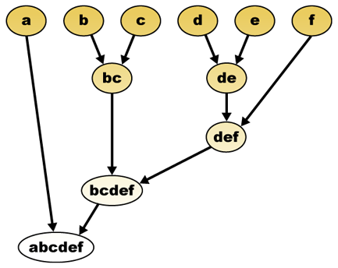
Agglomerative clustering

Slide 11
WOOGLE
Woogle search engine matches inputs or outputs by considering parameter names, their corresponding concepts, and the operations they belong to
Woogle’s agglomerative clustering is a big improvement from the keyword matching, but can we do better?

Slide 12
OUR goal
To introduce EMD as a partial keyword matching to existing web service search engine.
To experimentally evaluate the performance of EMD against Vector Space Model for Web Service Retrieval
To deploy EMD service search engine as a web application that can be used by WSDL providers or WSDL consumers

Slide 13
EMD – Earth mover’s distance
EMD is an evaluation method of dissimilarity between two multi-dimensional distributions
Given two distributions, one can be seen as a mass of earth properly spread in space, the other as a collection of holes in that same space. Then, the EMD measures the least amount of work needed to fill the holes with earth
Computing the EMD is based on the solution to the well-known transportation problem

Slide 14
EMD – TRANSPORTATION PROBLEM
Suppose several suppliers, each with a given amount of goods, are required to supply several consumers, each with a given limited capacity.
For each supplier-consumer pair, the cost of transporting a single unit of goods is given.
The transportation problem is then to find a least-expensive flow of goods from the suppliers to the consumers that satisfies the consumers' demand.

Slide 15
EMD – TRANSPORTATION PROBLEM
Matching signatures can be naturally cast as a transportation problem by defining one signature as the supplier and the other as the consumer, and by setting the cost for a supplier-consumer pair to equal the ground distance between an element in the first signature and an element in the second.
Intuitively, the solution is then the minimum amount of “work” required to transform one signature into the other.

Slide 16
EMD – Earth Mover’s Distance
EMD describes the normalized amount of work required to transform one distribution to the other
The subtask of our project is to find the EMD between a keyword and an attributed word sequence from a query and a record, which describes their similarity
This process will be performed for all records, and the one with the lowest EMD will be returned as the highest ranked result

Slide 17
EMD - ADVANTAGES
Allows for keywords of variable length to be matched
(e.g. ‘sale’ = ‘wholesale’)
Allows for partial matches in a very natural way. This is important, for instance, for image retrieval and in order to deal with occlusions and clutter.
Matches perceptual similarity better than other measures, when the ground distance is perceptually meaningful.

Slide 18
Computing emd
Let any subtask to involve two word sequence Kw and Aw(keyword and attributed word), where |Kw| = n₁ and |Aw| = n₂
Finding the minimum amount of work to transfer Kw to Aw we use the following linear program(LP) with variables f_{ij}(flow) and d_{ij} (ground distance matrix between Kw and Aw)

Slide 19
Computing emd
1.1 restrict the total outgoing flow from any Kw not to exceed the corresponding weight
1.2 limits the total incoming flow to any attribute word not to exceed the weight
1.3 ensure the “positiveness” of all flow
1.4 defines the amount of total flow which is equal to the minimum of Kw and Aw‘s total weight

Slide 20
COMPUTING EmD
From the linear program, if we assume that the optimal flow f* is found, we obtain the following EMD equation
To compute the EMD between two distributions we use the following formula:

Slide 21
S.E.D.
Before actually computing the EMD, we must decide the value of W_{kw} and W_{aw} (weight of the keyword and attribute word)
The weight of a word can be calculated by its length
We use the distance metric SED to compare the words character-wise

Slide 22
S.E.D.
Before actually computing the EMD, we must decide the value of W_{kw} and W_{aw} (weight of the keyword and attribute word)
diff is the number of difference characters
For example
SED(‘Car’, ‘City’) = 2 + 1 = 3

Slide 23
S.E.D. & L.D.
However, SED is not robust enough to capture words with similar structures
SED(‘Sale’, ‘Wholesale’) = 9
For words that have a common prefix of suffix, then EMD will use the LD technique to compute the weight
Edit distance(LD) between a Kw and an Aw is the least number of character insertions, deletions, and substitutions required to transform one to the other
LD(‘Sale’, ‘Wholesale’) = 5 since a minimum of 5 insertions are required

Slide 24
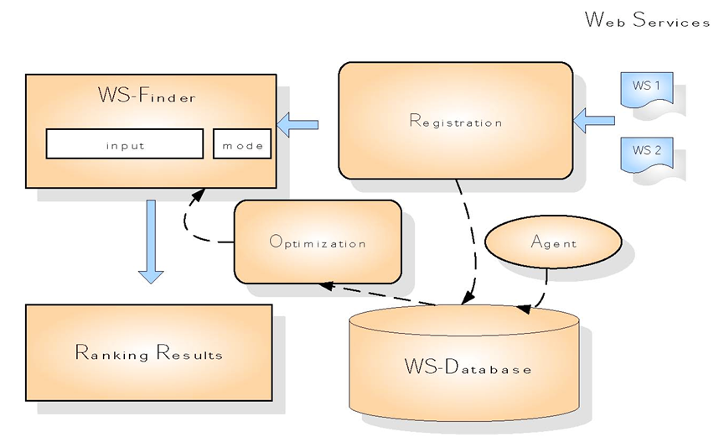
Solution
Our project will involve building the WS-Finder component, the Optimization component (EMD algorithm), and the WS-database

Slide 25
Our Approach
1) Parse WSDL files
Name, documentation, locations, IO names
2) Store WSDL data in a MySQL server
Assign each web service a unique ID
3) Index the data into index.txt
Create an index file for EMD. Each line in the index is a web service. Each web service is treated as a bag of words
WSDLs
MySQL
Index.txt

Slide 26
Our approach
4) Get user’s query and compute EMD
for each web service in the index file
5) Get ranked results from EMD
EMD will return the top 25 closest matched web services
6) Fetch web services from database
Return the matched web services to the user in ranked order
Index.txt
EMD
MySQL
User
Query

Slide 27
Precision & recall
Precision - The fraction of retrieved documents that are relevant to the search.
Recall – The fraction of the documents that are relevant to the query that are successfully retrieved.
Precision and recall." Wikipedia. N.p., n.d. Web. 26 July 2012. <http://en.wikipedia.org/wiki/Precision_and_Recall>

Slide 28
Vector Space model
To test our approach, we compared precision and recall to the current exact keyword matching standard which is the Vector Space Model (VSM)
The weight of the keyword in the VSM is defined:
w = tf * idf
We utilize MySQL’s normalized factor form of the VSM
w = (log(dtf)+1)/sumdtf * U/(1+0.0115*U) * log((N-nf)/nf)
For more info on how we use the MySQL VSM
http://forge.mysql.com/wiki/MySQL_Internals_Algorithms#Full-text_Search

Slide 29
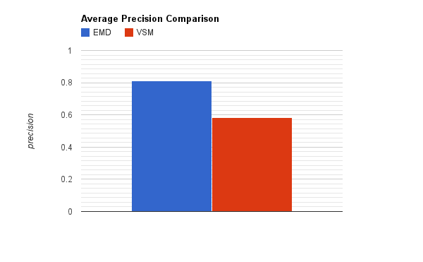
Average precision
Database Size: 454
EMD vs VSM

Slide 30
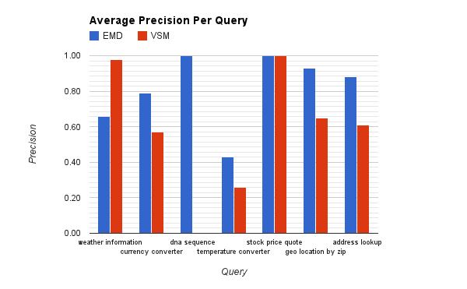
AVG PRECISION PER QUERY
Database Size: 454
EMD vs VSM

Slide 31
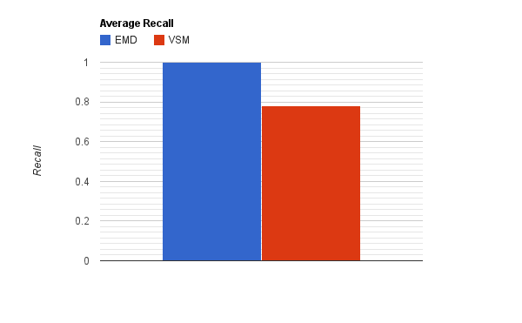
Average RECALL
Database Size: 454
EMD vs VSM

