Slide 1
Learning to Judge
Image Search Results for Synonymous Queries
Nate Stender, Dr. Lu

Slide 2
The Problem
There are billions of images on the internet.
When we search for an image we expect a result with relevant images.
Given a query, what is the best search term to use?

Slide 3
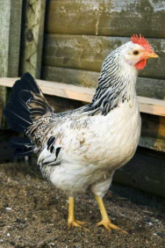
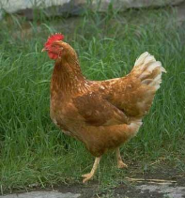
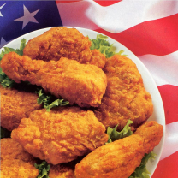
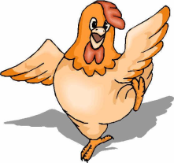
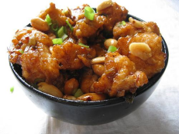
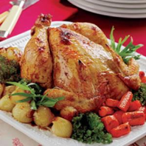
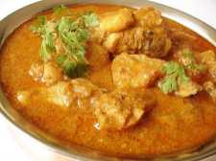
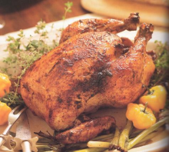
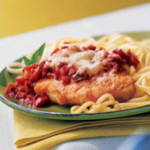
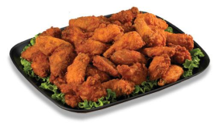
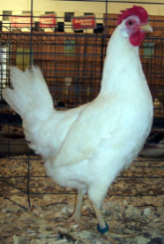
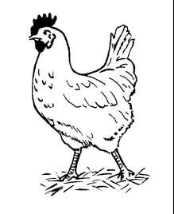
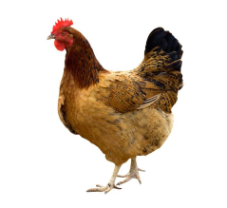
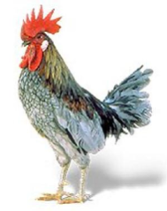
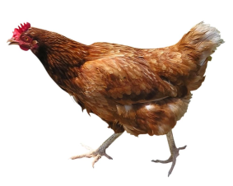

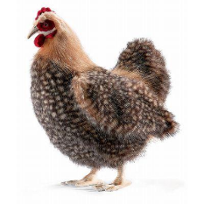
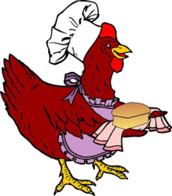
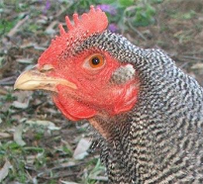
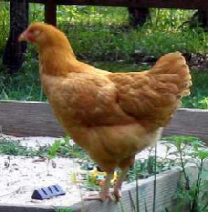
Example
Search results for “chicken”
Search results for “hen”

Slide 4
The Problem
How can we automatically determine the best search term?
It is not hard to suggest additions/modifications to search terms.
The hard part is deciding whether the suggestions actually improve the search results.

Slide 5
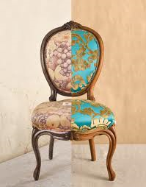
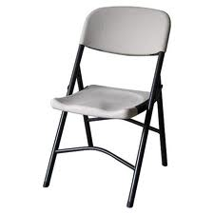
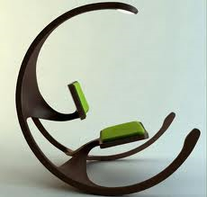
Challenges
Semantic gap
We do not have the ground truth!

Slide 6
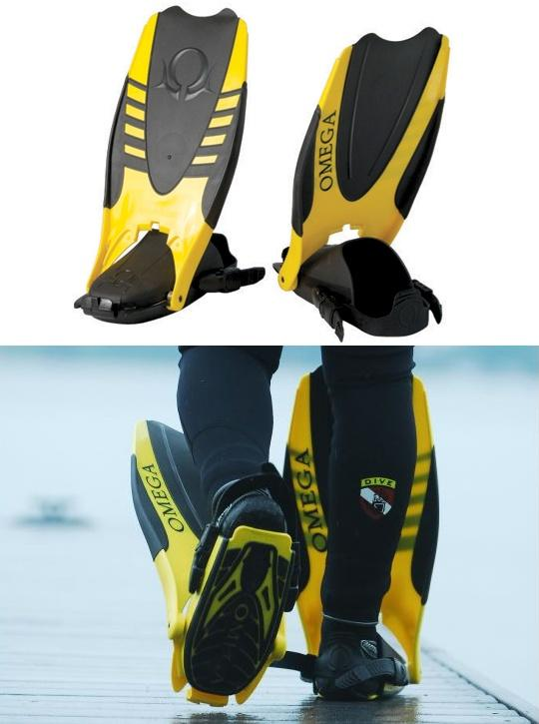
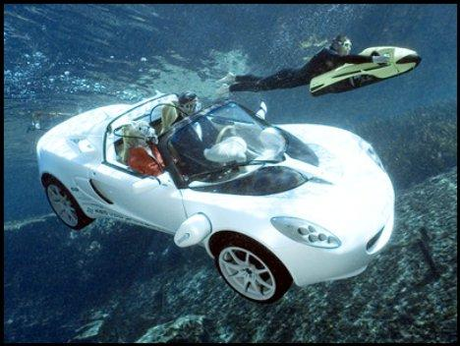
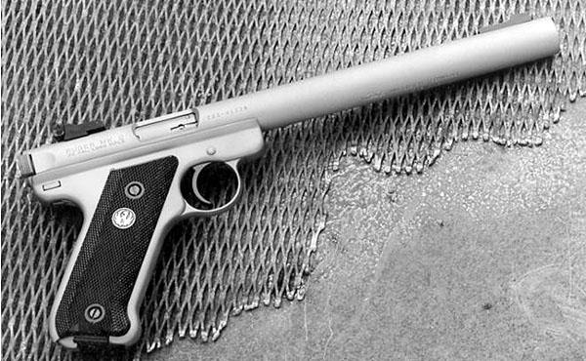
Challenges
Surrounding text is not enough!
…amphibians?

Slide 7
Our Approach
Make some useful assumptions about relevant results.
Construct a set of visual features based on these assumptions.
Propose a framework for training a machine learning algorithm to judge search results using these features.

Slide 8

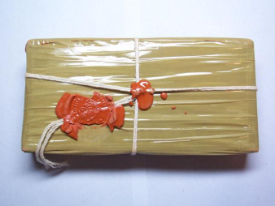

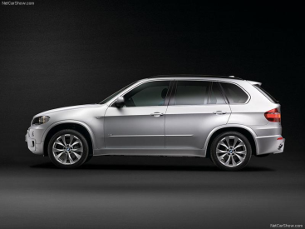
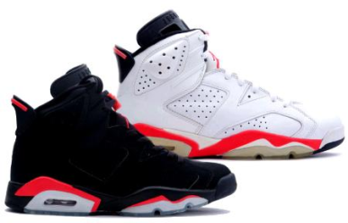

Assumptions
A better search result will rank relevant images higher.
We can identify differences in the visual distribution of relevant and irrelevant images.
Top 3 and Bottom 3 results returned for query “package”

Slide 9

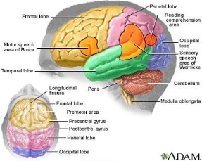
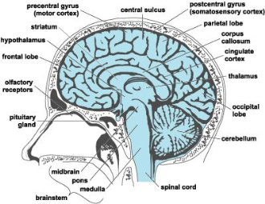
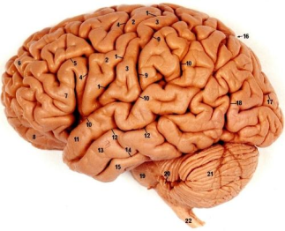
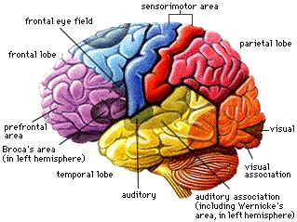
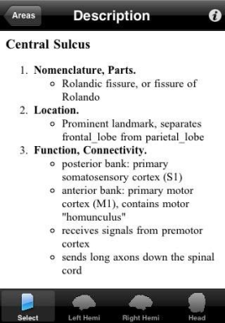
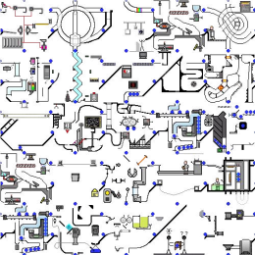
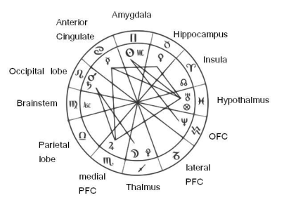
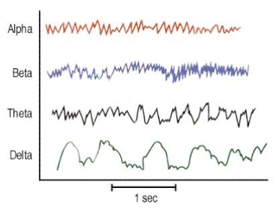
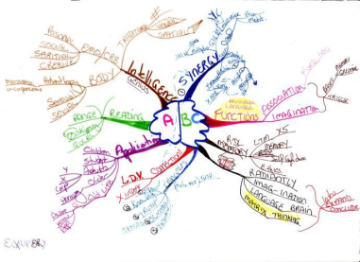
Visual Similarity Assumption
Relevant-relevant image pairs share higher visual similarity than relevant-irrelevant and irrelevant-irrelevant image pairs.
Top 5 Relevant “Brain”
Top 5 Irrelevant “Brain”

Slide 10



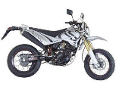




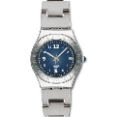
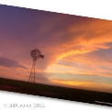

Visual Density Assumption
Relevant images have higher density than irrelevant images.
Visual Characteristics

Slide 11
The Approach
Preference Learning Model Framework
Training Set
Creation
Visual Characteristics Extraction
Feature Construction
RankSVM Algorithm
Testing Set Prediction

Slide 12
Training Set
97 queries, with 2 synonyms each from WordNet.
Top 200 images from Google.
Final result is a training data set of 38,800 images.
animal | fauna
baby | infant
ill | sick
lady | dame
road | street
glue | paste
bicycle | bike
money | cash
hen | chicken
dog | hound
rabbit | bunny
cloth | fabric
trash | rubbish
scared | afraid
ugly | hideous
depressed | miserable
car | automobile
circle | round
cat | feline
ruler | straightedge
coast | shore
color | pigment
grain | wheat
meadow | pasture
doctor | physician
beer | brew
limb | appendage
song | tune
man | guy
child | kid
world | Earth
god | deity
ocean | sea
bikini | swimsuit
horse | pony
wood | lumber
tsunami | tidal wave
person | human being
fire | flame
hill | mound
monkey | primate
frog | toad
pistol | handgun
soil | dirt
smile | grin
sunset | dusk
mind | brain
castle | fortress
movie | film
trail | path
battle | fight
snake | serpent
string | twine
twig | sprig
pig | hog
mouse | rat
ship | boat
spider | arachnid
backpack | bookbag
bathroom | lavatory
laboratory | research lab
magician | illusionist
tornado | twister
soda | pop
sandal | flip flop
parcel | package
journal | diary
headphone | earphone
crystal | quartz
sunglasses | shades
ghost | spook
brochure | pamphlet
curtain | drape
forehead | brow
fireplace | hearth
scribble | doddle
sweatshirt | pullover
submarine | U-boat
summit | peak
award | prize
stone | rock
lollipop | sucker
policeman | officer
dresser | bureau
slime | ooze
germ | microbe
hatchet | tomahawk
overweight | fat
stadium | arena
store | shop
ant | pismire
alien | extraterrestrial
rooster | cock
pew | church bench
book | novel
laptop | notebook computer
stomach | belly

Slide 13
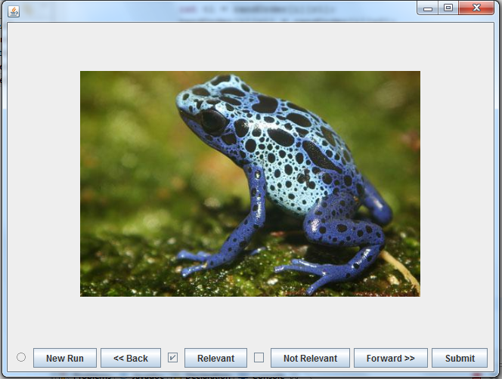

Training Set
Each image labeled for relevance.
Labels used to calculate Average Precision (AP).
AP used as ground truth as ground truth.

Slide 14
The Approach
Preference Learning Model Framework
Training Set
Creation
Visual Characteristics Extraction
Feature Construction
RankSVM Algorithm
Testing Set Prediction

Slide 15
Visual Characteristic Extraction
SIFT image features are extracted.
Features are clustered using k-means hierarchal clustering.
The centers of the clusters form “visual words”.

Slide 16
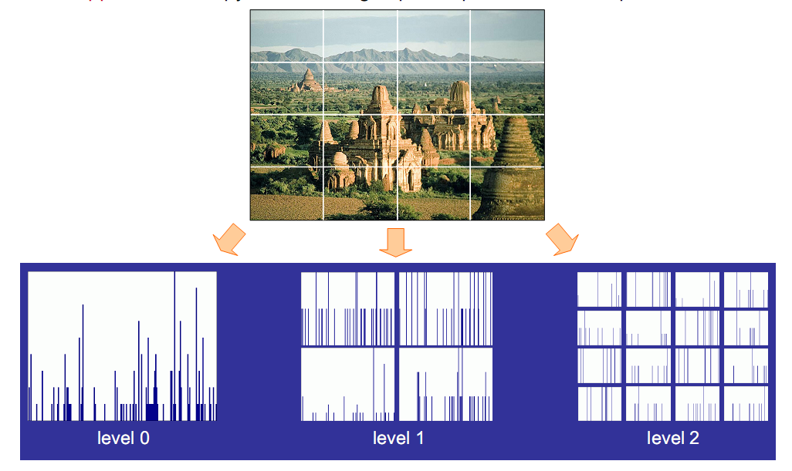
Visual Characteristic Extraction
Spatial Pyramid Matching

Slide 17
The Approach
Preference Learning Model Framework
Training Set
Creation
Visual Characteristics Extraction
Feature Construction
RankSVM Algorithm
Testing Set Prediction

Slide 18
Feature Construction
Visual Similarity
  Calculated as intersection of visual bag-of-words.
  Similarity matrix is formed, and split into k blocks.
  Mean and variance of each block is used as feature.
Similarity Assumption
H
L
L
L
Similarity Matrix M
1 2 … k
1
2
.
.
.
k
1 2 … N
F_{SD}(i) = [mean(M^{(i,i)}),var(M^{(i,i)})], i = 1, … , k

Slide 19
Feature Construction
Visual Density
  Calculated via Kernel Density Estimation.
  Ranked list of densities is split into k groups.
  Mean and variance of each group is used as feature.
Density Assumption
H
L
Density Vector p
1
1
2
2
.
.
.
.
.
.
.
.
.
k
N
F_{DD}(i) = [mean(p^{(i)}),var(p^{(i)})], i = 1, … , k

Slide 20
The Approach
Preference Learning Model Framework
Training Set
Creation
Visual Characteristics Extraction
Feature Construction
RankSVM Algorithm
Testing Set Prediction

Slide 21
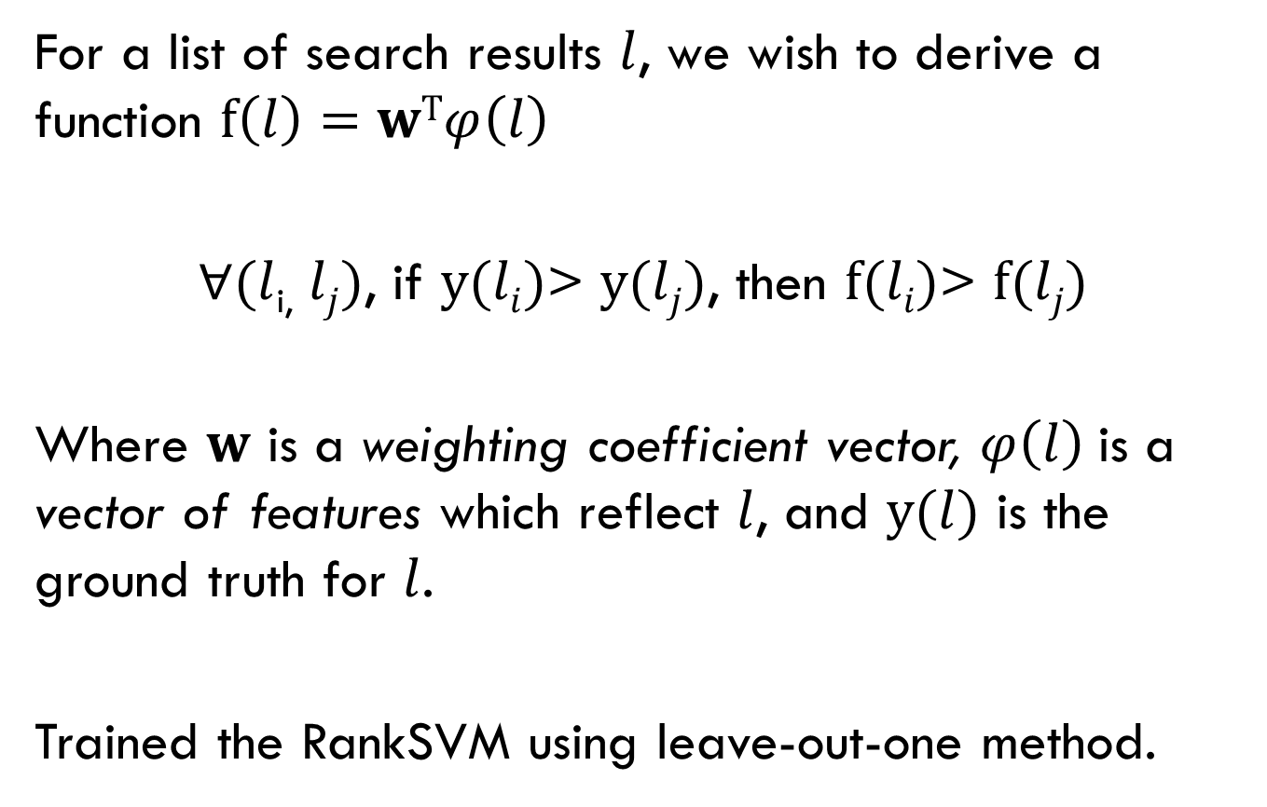
RankSVM Algorithm
For a list of search results $l$, we wish to derive a function $f\left(l\right)=wTφ\left(l\right)$
$∀(l$_{i,} $lj)$, if $y(li)$> $y(lj)$, then $f(li)$> $f(lj)$
Where $w$ is a weighting coefficient vector, $φ\left(l\right)$is a vector of features which reflect $l$, and $y(l)$ is the ground truth for $l$.
Trained the RankSVM using leave-out-one method.

Slide 22
The Approach
Preference Learning Model Framework
Training Set
Creation
Visual Characteristics Extraction
Feature Construction
RankSVM Algorithm
Testing Set Prediction

Slide 23
Testing Set Prediction
 | Base_{Orig} | Base_{Syn} | Select_{Random} | Select_{PLM} | Select_{Opt}
MAP@20 | 75.03 | 74.68 | 76.11 | 83.55 | 90.79
MAP@40 | 71.22 | 71.62 | 70.41 | 82.05 | 88.26
MAP@60 | 68.50 | 69.32 | 67.24 | 77.82 | 86.07
MAP@80 | 66.43 | 67.19 | 67.31 | 76.95 | 84.34
MAP@100 | 64.74 | 65.39 | 68.93 | 76.18 | 82.94
 | Kendall’s τ | Accuracy
T=20 | 0.2867 | 71.13
T=40 | 0.2855 | 63.92
T=60 | 0.2745 | 64.95
T=80 | 0.3295 | 68.04
T=100 | 0.3064 | 65.98

Slide 24
Contributions
Collected the first image dataset for synonymous queries.
This is the first attempt to use visual information to judge search results for synonymous queries.
We developed a framework for an image based preference learning model that could be applied to more problems in the future.

Slide 25
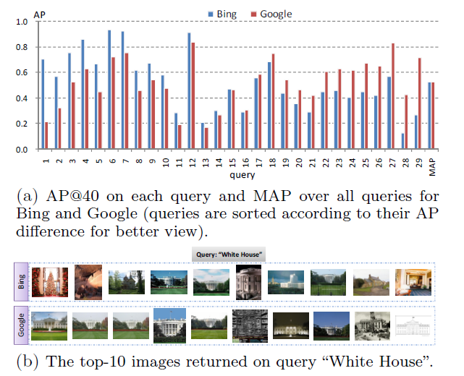
Other Applications
Search engine selection

Slide 26


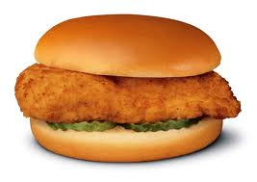
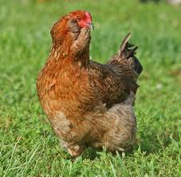

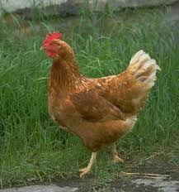


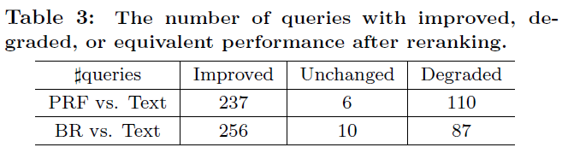
Other Applications
Re-ranking approach ability assessment
Image Re-ranking
Many different re-ranking algorithms: Pseudo-Relevance Feedback Re-ranking (PRF) , Bayesian Re-ranking (BR), ….

Slide 27
Future Work
Examine the possibility of creating a weighted merging of results.
Feature assumptions work well for concrete images (nouns, some adjectives) but not for abstract.
Incorporating textual as well as visual information to further improve predictions.

Slide 28
Acknowledgements
Texas State University – San Marcos
All the Faculty Mentors
David Anastasiu
Dr. Lu

Slide 29
Questions?

