Slide 1
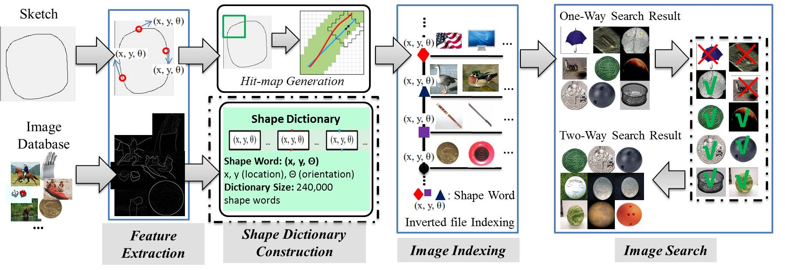
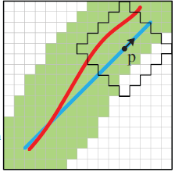
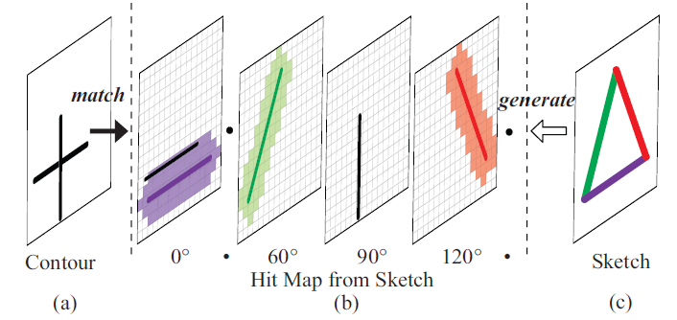
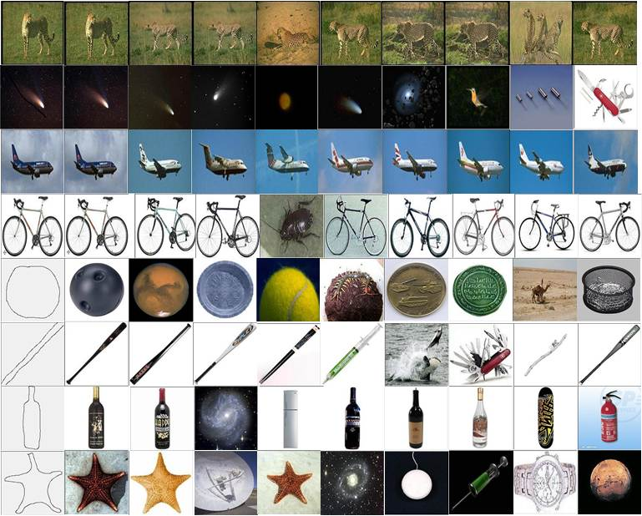
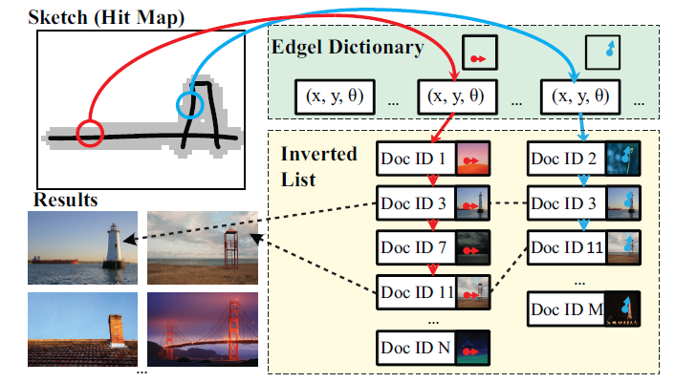
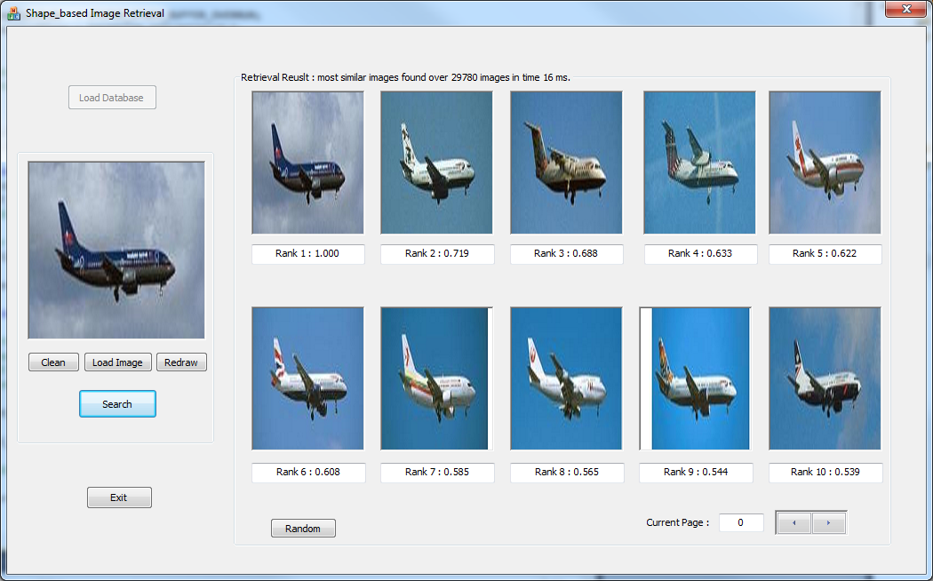
Large-Scale Image Retrieval From Your Sketches
Daniel Brooks¹,Loren Lin²,Yijuan Lu¹
¹ Department of Computer Science, Texas State University, TX, USA
² Department of Computer Science, University of Texas at Austin, TX, USA
Introduction
Framework
Hit Map Generation
The input sketch is translated in to a hit map with added tolerance.
Image Indexing
All pixels on the detected contours of the database are indexed in to an inverted index file.
Image Search
Compare the expanded query sketch to the inverted index file and return a short list of matched images.
Experiments & Results
In this project, we investigate the problems of large-scale sketch-based image search, and try to overcome two major challenges, indexing and matching.
An effective algorithm [1] is explored to describe images as a “bag of shape words” and an efficient indexing framework is utilized to make sketch-based image retrieval scalable to millions of images.
Our real-time sketch-based image search demo system is built on two popular datasets: Caltech 256 and ImageNet. Experimental results on various retrieval tasks (basic sketch search & shape based similar image search) show great promise for both accuracy and speed.
Image Collection
Caltech256 [2]
256 Categories: American Flag, Backpack, Bat, Base Ball, etc.
29,780 images.
ImageNet [3]
100 Categories Selected: Acoustic Guitar, Cab, Mountain, Mobile Home, etc.
100,843 images
Feature Extraction
Down-sample images to a maximal side length of 200 (a good balance between structure information preservation and storage cost).
Detect object contours for each image (Berkeley Detector [4])
User sketch input window design (200 × 200)
Extract the location (x, y) and orientation (θ) of each pixel on the input sketch and contours of each image in the database.
Shape Dictionary Construction
Shape Word Representation: (x, y, θ)
Location x, y: 1~200
Orientation θ: 1 ~ 6 (-15˚~15˚: 1; 15˚~45˚: 2; 45˚~75˚: 3; 75˚~105˚: 4; 105˚ ~135˚: 5; 135˚~165˚: 6)
Dictionary Size: 200*200*6=240,000 shape words
Problem
Pair-wise shape based matching is limited to small scale databases.
How to represent, index, and match shape to make shape based search scalable to a large dataset.
Hint: Text Words in Information Retrieval (IR)
Compactness
Descriptiveness
Document search is scalable
Good results with simple shapes & sketches.
Excellent speed scalable in to the millions.
Conclusions and Future Work
Bag-of-Word model
Demo System
Successful implementation of an edge pixel based inverted index algorithm for sketch based and similar image searching.
Plans to improve performance by enhancing our implementation to a two-way search.
Use this implementation of a state of the art solution as a benchmark when developing and testing our own original algorithm.
Of all the sensory impressions proceeding to the brain, the visual experiences are the dominant ones. Our perception of the world around us is based essentially on the messages that reach the brain from our eyes. For a long time it was thought that the retinal image was transmitted point by point to visual centers in the brain; the cerebral cortex was a movie screen, so to speak, upon which the image in the eye was projected.
China is forecasting a trade surplus of $90bn (£51bn) to $100bn this year, a threefold increase on 2004's $32bn. The Commerce Ministry said the surplus would be created by a predicted 30% jump in exports to $750bn, compared with a 18% rise in imports to $660bn. The figures are likely to further annoy the US, which has long argued that China's exports are unfairly helped by a deliberately undervalued yuan.
sensory, brain,
visual, perception,
retinal, cerebral cortex,
eye, cell, optical
nerve, image
Hubel, Wiesel
Retrieve
China, trade,
surplus, commerce,
exports, imports, US,
yuan, bank, domestic,
foreign, increase,
trade, value
A simple interface with a window to sketch or upload, with results displayed to the right.
Can an image’s shape be transformed into Bag-of-Shape-Words?
Image
Bag of ‘shape words’
Acknowledgements
This research is supported by the NSF REU Program and Texas State University.
References
[1] Yang Cao, Changhu Wang, Liqing Zhang, Lei Zhang, “Edgel Index for Large-Scale Sketch-based Image Search,” International Conference of Computer Vision and Pattern Recognition, 2011.
[2] Caltech 256, http://www.vision.caltech.edu/Image_Datasets/Caltech256/
[3] ImageNet, http://www.image-net.org/
[4] D. R. Martin, C. C. Fowlkes, and J. Malik. “Learning to detect natural image boundaries using local brightness, color, and texture cues”. PAMI, 2004.

