Slide 1
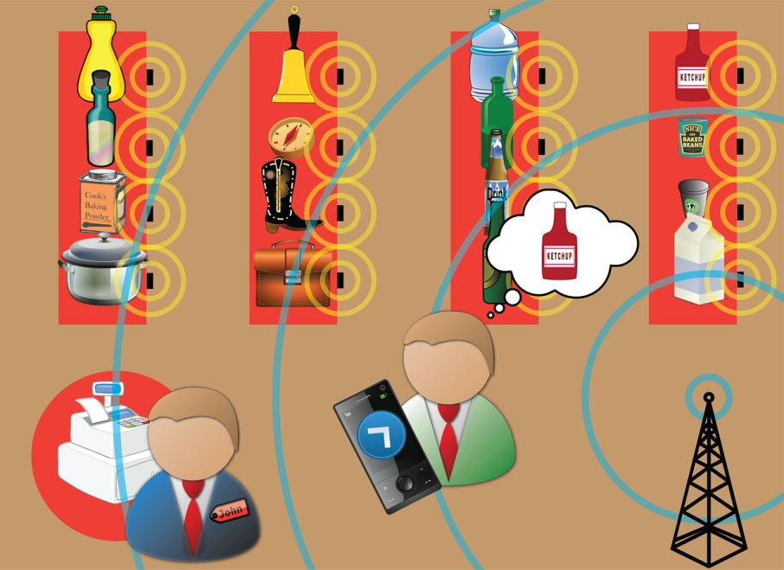
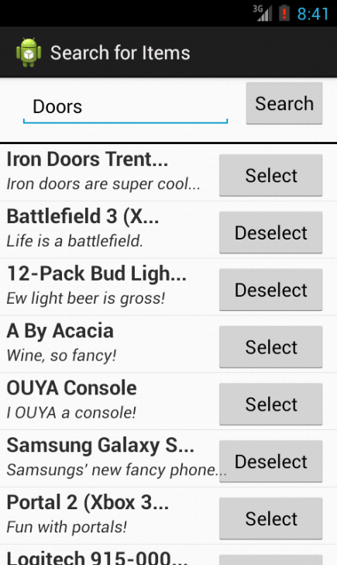
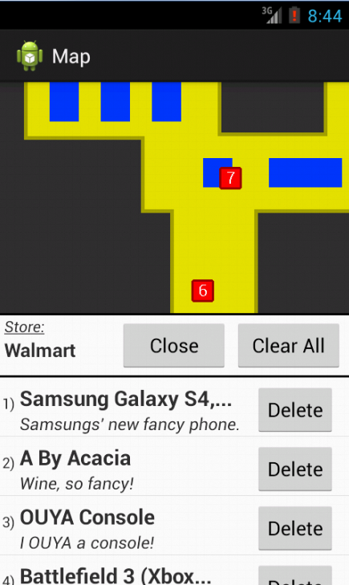
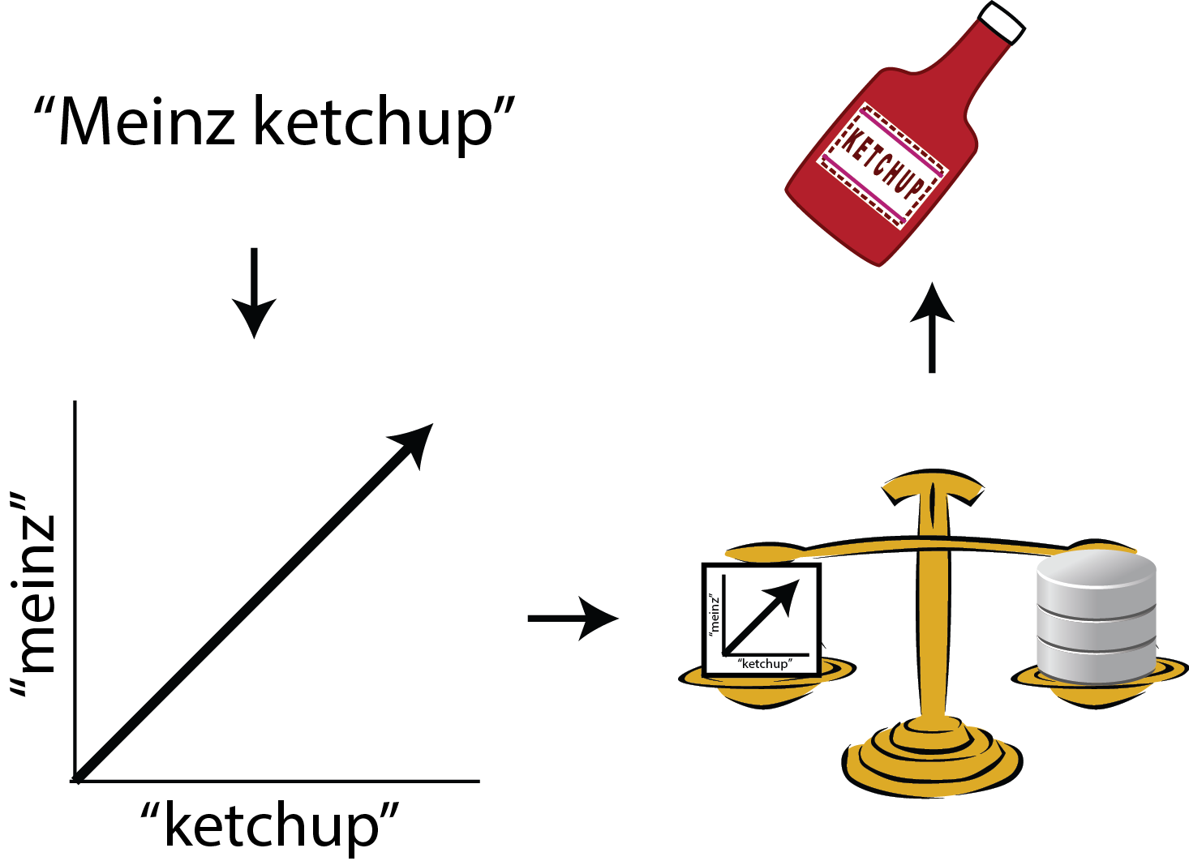
SmartMart: An IOT-based In-store Mapping Service for Mobile Devices
Faculty Mentor: Dr. Byron Gao, Texas State University – San Marcos
Hannah Bowles
College of Science and Engineering
Texas State University – San Marcos
K. Rodman Mannix
College of Engineering
Boston University
Dylan Hicks
School of Engineering and Applied Science
Columbia University
Abstract
RFID Localization
Quite often, when shopping in a supermarket (e.g., Wal-Mart), we are frustrated at locating the items on the shopping list and no assistance is available. The objective of this project is to leverage the Internet of Things (IOT) technology to make the store items ``smart" so that they can automatically register and update their location information, allowing customers to search, locate, and map them on the store floor plan using mobile devices. Advanced features include recommending routes, computing shortest paths for multiple items on the shopping list, and facilitating progressive search and personalized search. To our best knowledge, it is the first mobile app of this kind. Existing shopping apps do not provide location-based services. It is also quite different from Google Indoor Maps that only displays indoor floor plans and does not support searching and mapping of dynamic store items on the floor plan.
Radio Frequency Identification devices will continuously scan the area for tags, and use the Received Signal Strength (RSS) to calculate the distance. Many algorithms have been explored using multiple readers to maximize accuracy in 2 dimensions. Methods include basic triangulation, dynamically updating calibration with reference tags, probability algorithms, and K-nearest-
neighbor algorithms. The most successful systems must also take into account reader and reference tag placement.
Calculations in Dynamic Environments
Fluctuating signal strengths and interference in a dynamic environment must be compensated for. The graph on the right shows the raw data taken from our reader. The fluctuations are due to interference such as doorways catching the signal, metal in the building, and people walking by. In a store environment, we estimate that the margin of error that would allow for our app to retain functionality is 1-2 meters. We are confident that with multiple readers and careful choice of localization algorithms this can be accomplished.
Mobile Application
Search Activity
Item Database Server
Product Demo
The end-product of this research will be in the form of a mobile application. Currently, this mobile application has only been developed for Android devices. The application has been developed to run as efficiently as possible, and can communicate with a server to receive XML files based on user input. The application can be divided into two major screens – the Search Activity and the Map Activity.
Search Activity
This activity is where queries are sent to the server and data is received back. A user will enter a keyword in the search box and click the “Send” button, which will return each associated result in order of relevance in its own row. The user will have the option to add an item to their ‘shopping list,’ or if the item is already there, remove it. Users can add an unlimited number of items to their ‘shopping list.’
Map Activity
This activity does the grunt of the work on the client-side of this project. It takes XML files that describe the locations of map floors and shelves and uses the Android Draw and Canvas classes to dynamically draw a map. It then processes and parses the user’s ‘shopping list’ to place markers in the proper locations on the map to identify each object. These markers can be clicked on for more information. It has a collapsible list from which users can delete items from their ‘shopping list.’
First the terms are found by removing the punctuation and applying the Porter stemmer. Then the server indexes each searchable field by placing the terms into an inverted index. This index is used when the server is queried by creating a vector space model from the data. This model takes the term frequency and inverse document frequency and creates a vector representing each document.
Then, the query is represented as a vector as well and the cosine similarity between the query and each document is computed. Each field has its own weight so that more important fields, such as product name, score better than tertiary fields, like product description. Then the results are sorted by score and sent to the client side mobile application.
Our demo uses one reader and 2 reference tags to calculate the location of two sample active tracking tags. We take incoming RSS values from the reference tags along with a maximum RSS value, and find linear fits. Incoming tag data is then fit to one of those lines to determine it’s location in one dimension. We believe this maximizes the accuracy we can achieve with one reader.
User enters search
terms here
Initiates server query
with keyword
If a user already has an
item in their shopping
list, they can remove it
reader
Known RSS at this point
Ref1
Ref2
If an item is not in
the shopping list,
a user can add it
RSS = Slope₁ * Dist + B₁
RSS = Slope₂ * Dist + B₂
Future Work
Yellow areas mark the floor
The potential applications and integration of this project are vast – many large department and grocery stores alike could find the implementation of this project quite useful. For the demonstration of this project, only linear distances were used to mark objects along one axis. Both the client side (the mobile application) and server side have been built with the framework to support 2-dimensional item mapping, but would require at least two readers.
On a large scale with many readers, the accuracy of the item location will improve drastically. Stores may implement this project to dynamically track product location and deliver this information to customers.
Areas in blue represent shelves
Red rectangles are markers
that represent the items in the list with the same number
This button will collapse the list
so only the header can be seen
This will remove all items
from the list
Each item has its own row and
a button to delete from the list
Map Activity

Slide 2
Hannah Bowles
College of Science and Engineering
Texas State University – San Marcos
RSS = Slope₁ * Dist + B₁
Dylan Hicks
School of Engineering and Applied Science
Columbia University
HELLO

