Slide 1

Minimum Spanning Tree Optimizations
Randy Cornell
Advised by: Martin Burtscher
Department of Computer Science
CS 4299: Undergraduate Research
Notes:
Line Numbers x
Title Capt X

Slide 2
Presentation Structure
Introduction
Other people’s approaches
  Classical approaches
  Modern approaches
Our approaches
Result analysis
Conclusion
Notes:
Make Titles one line

Slide 3
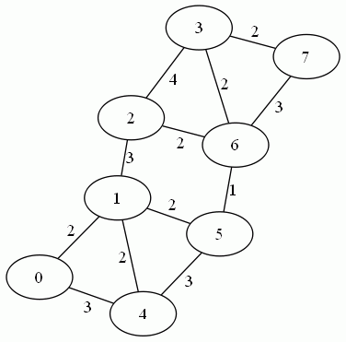
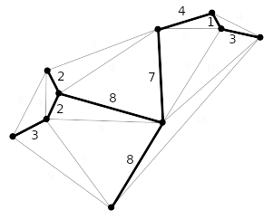
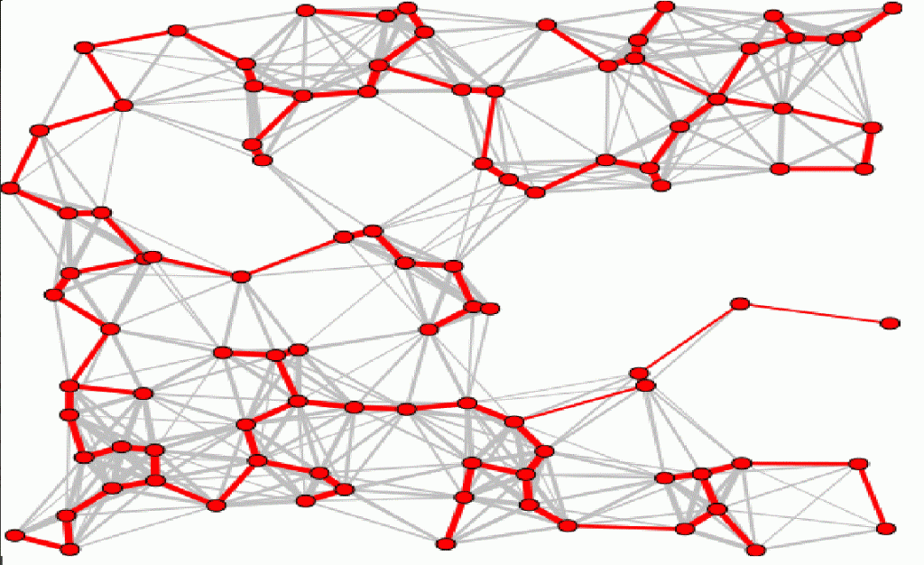
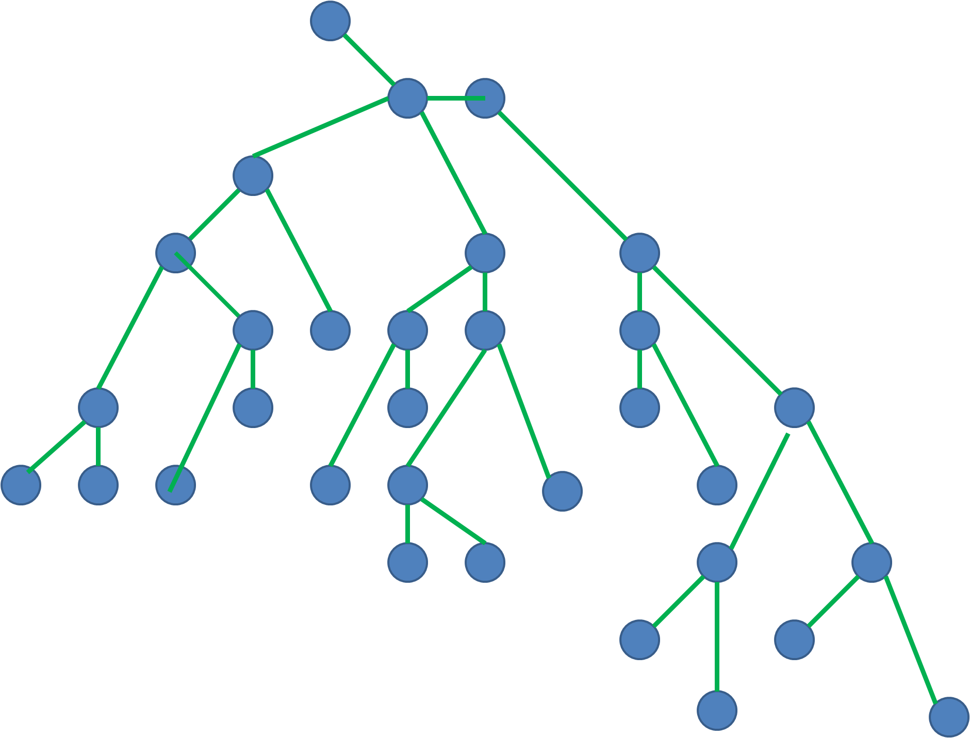
Introduction
The Minimum Spanning Tree (MST) problem is a graph problem.
The input graph has the following properties.
  It must be a single connected component.
  It must be an undirected graph.
  It must have edge weights.
Here are the properties of the output graph.
  It must be a tree (no cycles).
  It must contain a connection to all nodes from the initial graph.
  It must be the lightest possible graph that follows the previous conditions.
Undirected Weighted Graph
Minimum
Spanning
Tree
Notes:
Increase font size 3 -4

Slide 4
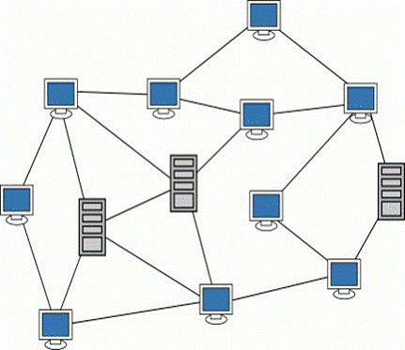
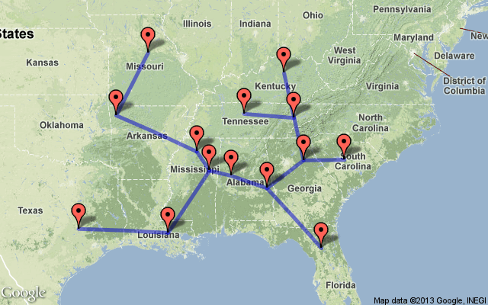
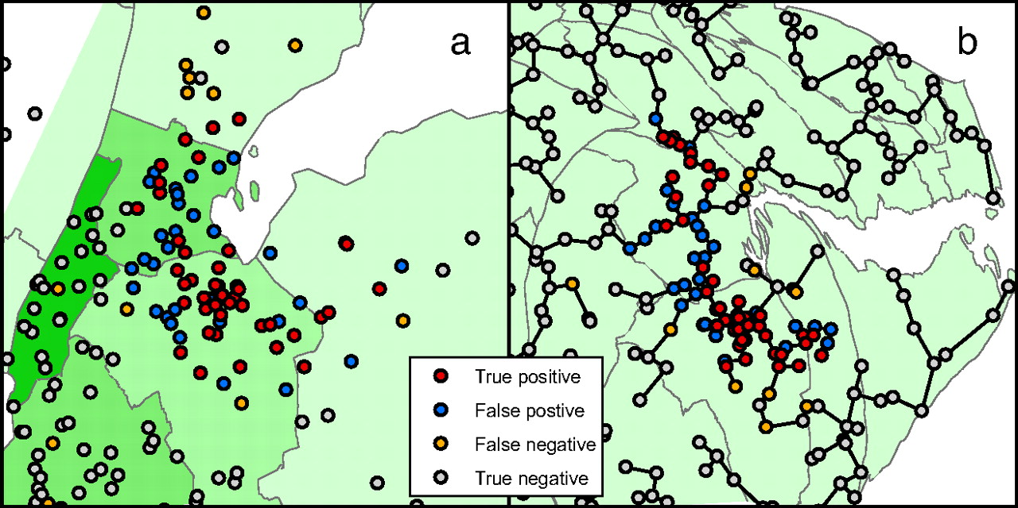
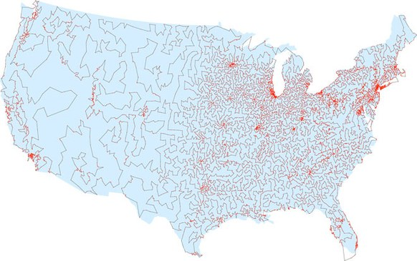
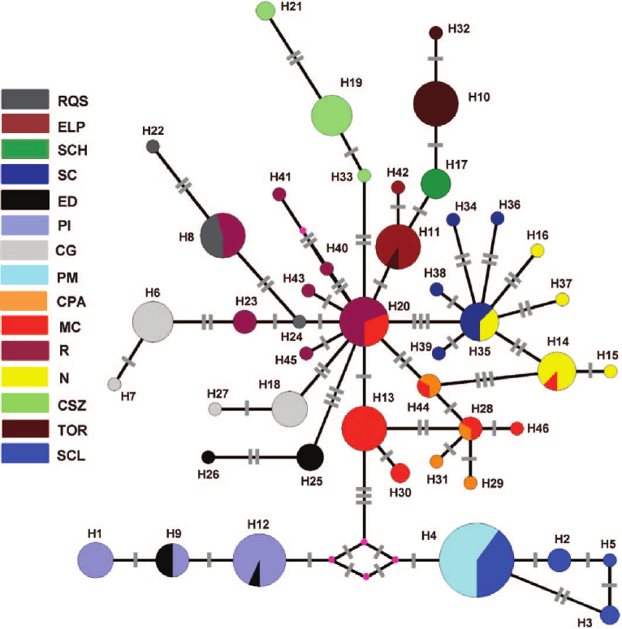
Introduction
Computer Networks
Road Networks
Medical Maps
This problem has many important applications
  Network design
    Communication networks
    Road networks
    Utility networks
  Approximation for NP-hard problems
    Traveling Salesman Problem
    Steiner Trees
  Computer Science
    Computer vision
    Handwriting recognition
    Image registration
    Cluster analysis
  Other various applications
    Biology
    Medical
    Engineering
    Finance
TSP Approximation
Biology

Slide 5
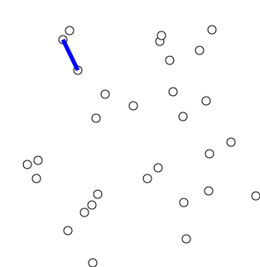
Classical Approaches: Prim’s (Dijkstra’s)
For Prim’s Algorithm you do the following
  Add any node to the MST
  Find the lightest edge leading outside of the MST
  Add the destination node to the MST
  Repeat until you have an MST
Prim’s Algorithm
Notes:
You then find the lightest edge connected to a node in the MST to a node outside of the MST
Find the lightest edge that connects to a node outside of the tree
You then add the outside node to the tree and repeat adding edges (step 2) until you have the number of nodes – 1 edges

Slide 6
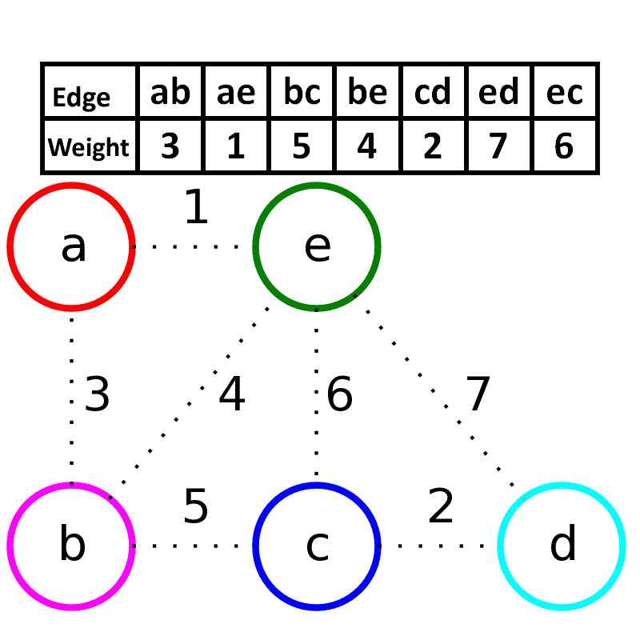
Classical Approaches: Kruskal’s
For Kruskal’s Algorithm you do the following
  Sort edge list
  Check if the lightest edge creates a cycle
  If it does not create a cycle add it
  Repeat until you have an MST
Kruskal’s Algorithm
Notes:
You first take your edge list and sort it from lightest to heaviest edge
You then will go through from the lightest edge and you will add it as long as it doesn’t create a cycle
You will repeat until you have nodes – 1 edges in the MST

Slide 7
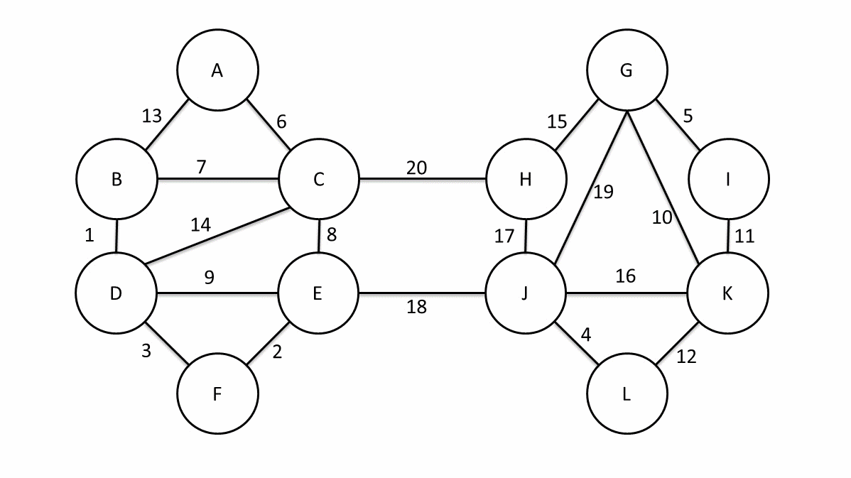
Classical Approaches: Boruvka’s
For Boruvka’s Algorithm you do the following
  First make every node a tree
  Find the lightest edge leading outside of the tree
  Merge trees together that are connected via these lightest edges
  Repeat until you have an MST
Boruvka’s Algorithm
Notes:
You will start out by going to every node and finding its lightest edge
You then will use these edges to merge nodes connected into trees
For the next step you will find the lightest weight for the tree and then continue until you have a single tree and only nodes – 1 edges left

Slide 8
  Modern Approaches
Prim
  Priority queues
    Binary
    Binomial
    Fibonacci
  Fredman and Tarjan
Kruskal
  Bucket sorting
  Filter Kruskal
Boruvka
  Yao
  MST verification
Combinations
Other various
  Non-Greedy
  Vertex removal

Slide 9
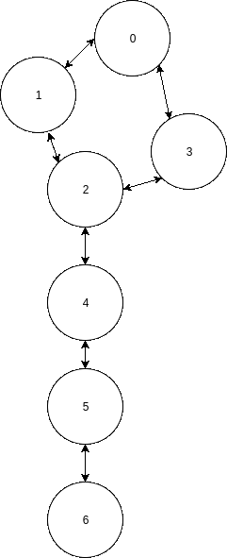
Our Approaches: Linked List Removal
Linked List Removal
Most graphs have a large number of nodes that only connect to 1 edge
  These edges have to be in the MST
    Remember the spanning property
If this edge leads to a node with 2 edges
  These edges have to also be in the MST
  This is due to the fact that it takes 2 edges that could form a cycle
    We know that an edge leading to single node cannot form a cycle
    So you can add the other edge that this node is connected to
This leads to improvement
  You do not have to track as many trees
  Fewer nodes to sort (Kruskal)
Notes:
In Most of these graphs they have a large amount of Nodes that only connect to 1 Edge (10% - 20% on average)
We can add these edges to the MST from the start because we know that they are bridge edge (If you remove them then you end up with more components then what you started with)
But we can take this one step further if this one edged node is connected to a 2 edged node then we can add the other edge to the MST because we will know that the other edge is also a bridge (This removes around another 5% – 10%)
But Another thing to notice is that this also helps through out the runtime due to you having to tract less information due to you not having to worry about these nodes trees
If using Kruskal in combination with bucket sorting you can reduce the number of buckets you sort

Slide 10
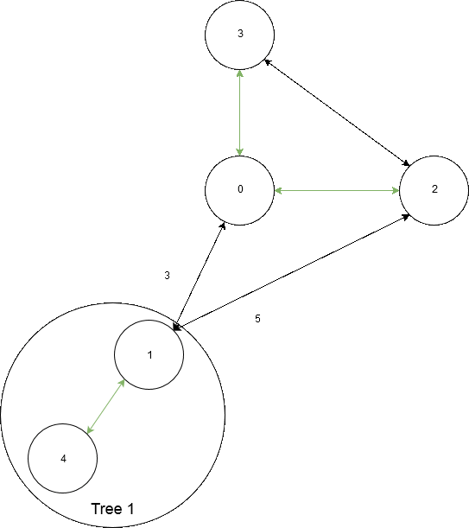
Our Approaches: Skipping Edges
With Boruvka you can determine that certain edges cannot be in the MST
  The edge creates a cycle
  The non-lightest edge connecting the same trees
You can also determine the same thing about nodes as well
  If there are no viable edges
Different Cases with Skipping Edges
Notes:
In Boruvka you will add edges to the MST and can determine that some edges can not be in the MST. (Due to the edge going and coming from the same tree)
If you remove these edges then you can shorten the list of edges that you go through in each step of Boruvka
You can take this further and if all of a node’s edges have either been added or determined to not be in the MST you can also remove these edges from the list

Slide 11
Input Graphs: Edge & Nodes

Slide 12
Input Graphs: Degree Distribution

Slide 13
  ECL Codes Comparison
Serial Version
  Boruvka
    Baseline
    Edge Skipping
    Linked List Removal
  Kruskal
    Baseline
    Bucket Sorting
    Linked List Removal
  Prim
    Edge based
    Node based
OpenMP
  Boruvka
  Kruskal
  Prim

Slide 14

Result Analysis: Comparison Code
Serial
  Boost
    Industry standard
    Well documented
    General graph solving C++ library
    Kruskal and Prim version
Notes:
This is a industry standard that is a c++ library written to quickly solve graphing problems
There is a Kruskal version and a Prim Version
This parallel code solves many different graph problems. It comes from the University of Texas and Texas State and was one of the only open and recent codes in CUDA
Result not result’s

Slide 15
Result Analysis: Serial Runtime Comparison
On average our Kruskal baseline code was 4.5 times faster than Boost’s
On average our Boruvka baseline code was 1.07 times faster than Boost
Notes:
Add Units X

Slide 16
Result Analysis: Serial Boruvka Comparison
This led to a 1.5 times improvement over Boost
Notes:
On average this improved from our baseline 30%
Fix lead

Slide 17
Result Analysis: Serial Kruskal Comparison
This led to a 5.5 times improvement over Boost
Notes:
On average this improved from our baseline 15%

Slide 18
Result Analysis: OpenMP Runtime Comparison
On average our Kruskal OMP was 2.3 times faster than our serial
On average our Boruvka OMP code was 3 times faster than our serial
Notes:
Add core numbers

Slide 19
Conclusion
Our code out performs Boost
  Our Boruvka is 1.5 times faster
  Our Kruskal is 5.5 times faster
Be careful when relying on big O
Don’t forget that smaller optimizations can still lead to improvements
    Edge Skipping
    Linked List Removal
Sometimes it is better to break your problem into individual parts if you can
  For example: The connectivity and the weights can be broken into separate problems
Notes:
Talk about results

Slide 20
Questions?

Slide 21
References
https://stackoverflow.com/questions/8025342/undirected-graph-conversion-to-tree
http://www.geeksforgeeks.org/applications-of-minimum-spanning-tree/
http://www.geeksforgeeks.org/applications-of-minimum-spanning-tree/
https://www.researchgate.net/figure/236240895_fig2_Fig-2-Minimum-spanning-tree-of-46-mitochondrial-DNA-haplotypes-of-Ctenomys-talarum-is
http://cs-pages.blogspot.com/2011/10/what-is-real-world-scenario-where.html
http://www.pnas.org/content/104/22/9404/F2.expansion.html
https://www.wired.com/2013/01/traveling-salesman-problem/
https://commons.wikimedia.org/wiki/File%3APrimAlgDemo.gif
https://commons.wikimedia.org/wiki/File%3AKruskalDemo.gif
https://commons.wikimedia.org/wiki/File%3ABoruvka's_algorithm_(Sollin's_algorithm)_Anim.gif
https://upload.wikimedia.org/wikipedia/commons/c/cd/Boost.png
http://www.boost.org/doc/libs/1_59_0/libs/graph/doc/graph_theory_review.html
https://www.cs.unm.edu/~moret/mst.ps
http://www.cs.princeton.edu/~wayne/cs423/lectures/fibonacci-4up.pdf
https://www.cs.princeton.edu/courses/archive/fall03/cs528/handouts/fibonacci%20heaps.pdf
http://ac.els-cdn.com/0167642383900114/1-s2.0-0167642383900114-main.pdf?_tid=f200c8f4-425b-11e7-95d3-00000aab0f27&acdnat=1495835012_236fc24bc29774a56e01a8ba89a593ea
http://algo2.iti.kit.edu/documents/algo1-2014/alenex09filterkruskal.pdf
https://www.cc.gatech.edu/~bader/papers/MST-JPDC.pdf
http://leeds-faculty.colorado.edu/glover/221%20-%20An_in-depth_empirical_investigation_of_non-greedy_approaches_to_the_MST.pdf
http://ac.els-cdn.com/S1877050916316325/1-s2.0-S1877050916316325-main.pdf?_tid=c3b1986e-464a-11e7-9cef-00000aacb35e&acdnat=1496267438_7e5a27fcc1cb7355a9d540720f4c7c73
https://archive.org/details/oeloglogvalgorit691yaoa
http://algo2.iti.kit.edu/documents/algo1-2014/alenex09filterkruskal.pdf
https://pdfs.semanticscholar.org/2574/a87cb4e36d0bf8994ce2bf02243a5eefb278.pdf
http://ac.els-cdn.com/0167642383900114/1-s2.0-0167642383900114-main.pdf?_tid=f200c8f4-425b-11e7-95d3-00000aab0f27&acdnat=1495835012_236fc24bc29774a56e01a8ba89a593ea

