Slide 1
Power Characteristics of Irregular GPGPU Programs
Jared Coplin and Martin Burtscher
Department of Computer Science

Slide 2
Introduction
GPU-based accelerators
Used in high-performance computing
Spreading in PCs and handheld devices
Power and energy efficiency
Power heat
Electric bill and battery life
50x boost in performance per watt for exascale computing
Important research area
Need to develop techniques to reduce power and energy
Have to develop an understanding of the power consumption behavior of regular and irregular programs
Power Characteristics of Irregular GPGPU Programs

Slide 3
Regular vs. Irregular Algorithms
Regular
Not data dependant
Can determine dynamic behavior based only on
Input size (not values)
Data structure starting addresses
Example: Matrix-vector multiplication
Irregular
Control flow and/or memory access patterns are data dependent
Runtime behavior cannot be statically predicted
Example: BST
Values and their order affect the shape of the binary search tree
Power Characteristics of Irregular GPGPU Programs
3

Slide 4
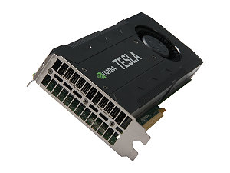
Benchmark Programs
LonestarGPU: common, real-world irregular codes
Barnes-Hut (BH)
Breadth-first Search (BFS)
Delaunay Mesh Refinement (DMR)
Minimum Spanning Tree (MST)
Points-to-Analysis (PTA)
Single-Source Shortest Paths (SSSP)
Survey Propagation (NSP)
Parboil: mostly regular, throughput-computing codes
Lattice-Boltzmann Method Fluid Dynamics (LBM)
Two-Point Angular Correlation Function (TPACF)
Sparse Matrix Vector Multiplication (SPMV)
Power Characteristics of Irregular GPGPU Programs
4
Notes:
TPACF - used as a way to measure the probability of finding an astronomical body at a given angular distance from another astronomical body

Slide 5
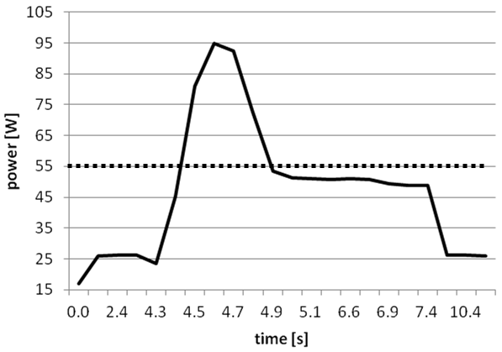
Methodology
Test bed
K20c compute GPU
K20 Power Tool
Three frequency settings: default, 614, and 324
Multiple program inputs and implementations
Figure 1: Sample power profile
Active Runtime
Tail Power
Power profiles
Power as a function of time
Idle Power
Idle Power
Tail Power
Active threshold
Active Runtime
Power Characteristics of Irregular GPGPU Programs
5

Slide 6
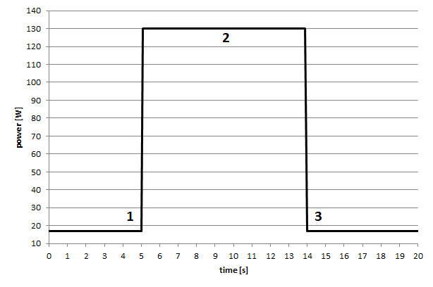
Idealized Power Profile
Figure 2: Idealized power profile
1. GPU receives work
2. Power draw stable
3. All cores finish
Profile can be captured with two parameters: active runtime and average power
Power Characteristics of Irregular GPGPU Programs
6

Slide 7
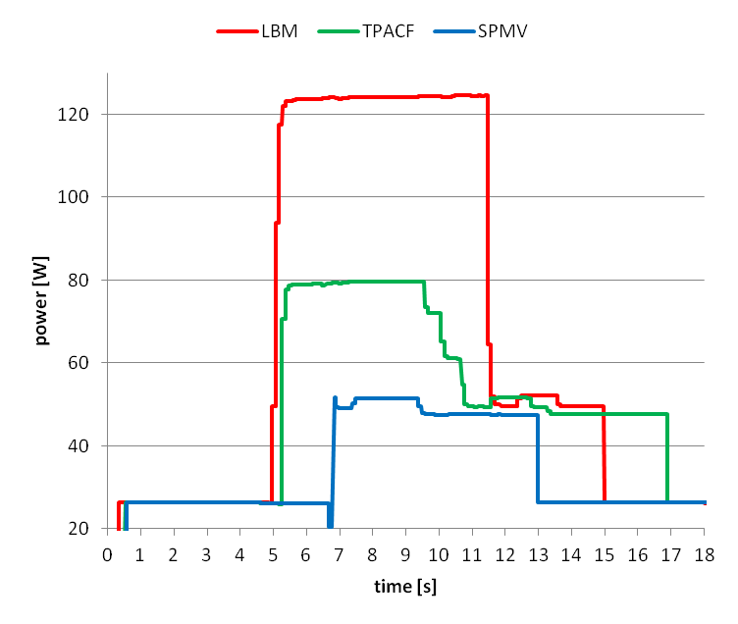
Regular Codes
Figure 3: Power profile of three regular codes
Active power not quite constant
Profiles basically follow idealized shape
Power peaks at different levels
Power Characteristics of Irregular GPGPU Programs
7

Slide 8
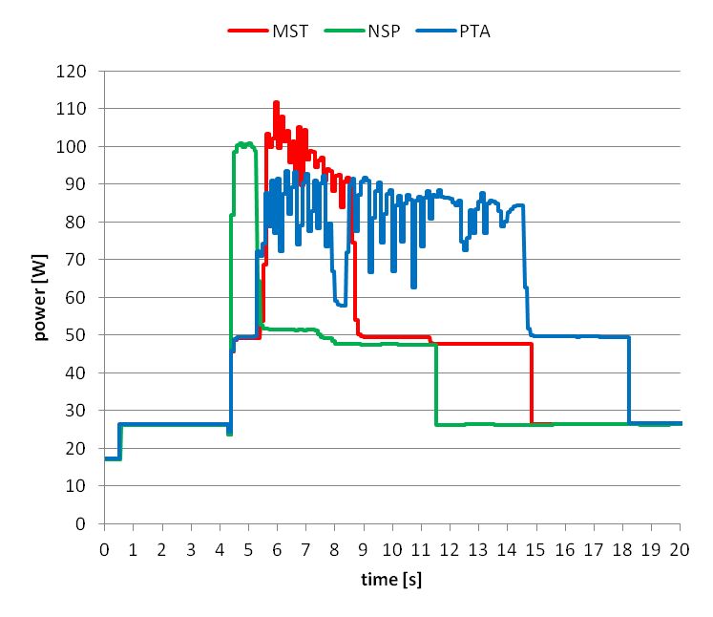
Irregular Codes
MST and PTA
Profiles contain many peaks and valleys
Dynamically changing data dependencies
No such thing as a standard profile for irregular codes
NSP
Topology driven
Exhibits regular power behavior
Figure 4a: Power profile of irregular codes
Power Characteristics of Irregular GPGPU Programs
8

Slide 9
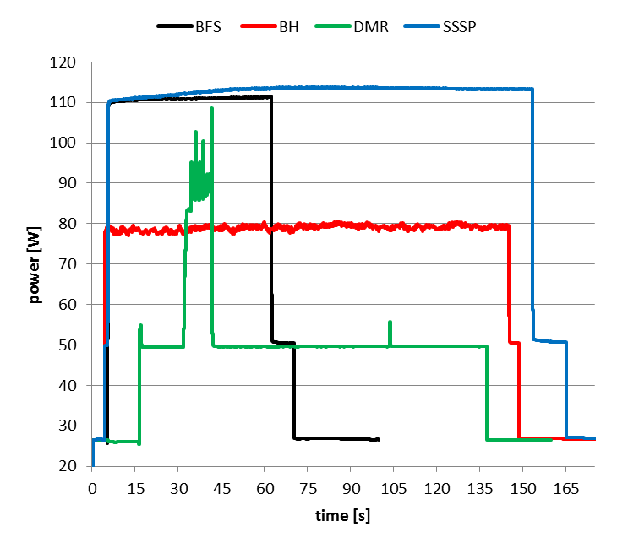
Irregular Codes (cont.)
BFS and SSSP
Topology driven
Exhibit regular power behavior
Lots of unnecessary work
DMR
Many peaks and valleys
~90 seconds of near idle power shows loss of parallelism
BH
Appears mostly regular
10k bodies, 10k timesteps
Irregularity is masked by short runtimes of individual kernels
Figure 4b: Power profile of irregular codes
Power Characteristics of Irregular GPGPU Programs
9

Slide 10
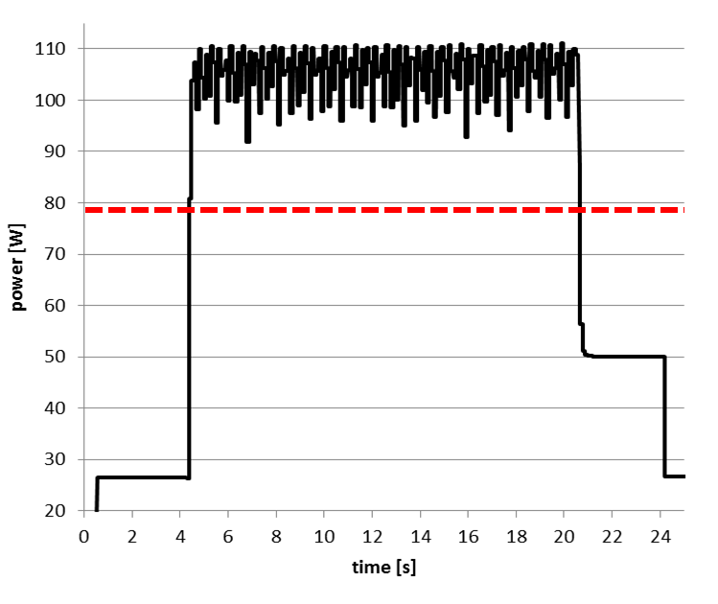
BH 100k Bodies, 100 Time Steps
100k bodies, 100 timesteps
Kernel invocation evident
Higher average power draw with 100k bodies over 10k bodies (red dashed line)
10k bodies not enough to fill GPU
Irregularity within each timestep still not visible
Figure 5: Power profile of BH with 100k bodies and 100 time steps
Power Characteristics of Irregular GPGPU Programs
10

Slide 11
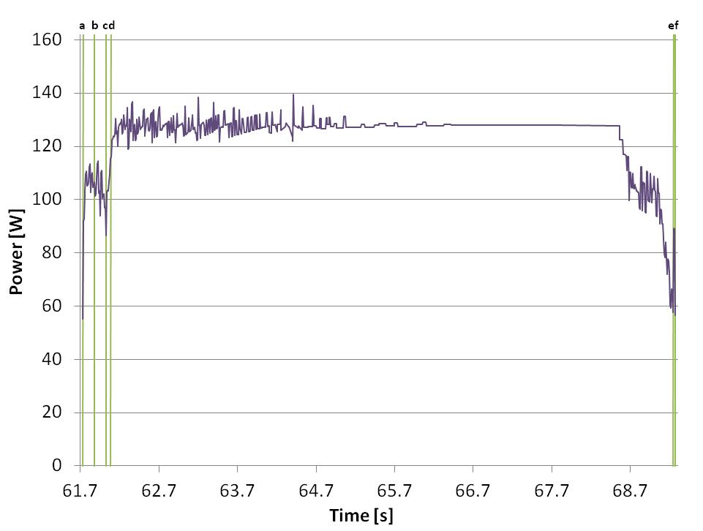
BH 22M bodies, Single Time Step
Regularized main kernel
Two similar irreg. kernels
Decrease due to load imbal.
One more irreg. kernel
Very short regular kernel
Power Characteristics of Irregular GPGPU Programs
11

Slide 12
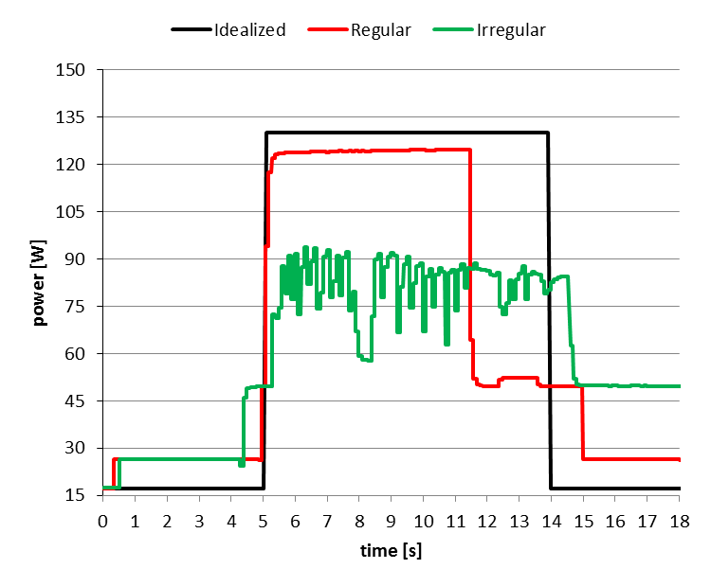
Idealized-Regular-Irregular
Idealized and Regular
Similar shapes
Irregular
Obviously different
Load imbalance
Memory access patterns
Control flow
Power fluctuates wildly
Averages 82W
From high to low, 60% difference
Cannot be accurately captured by averages
Figure 6: Comparison of idealized, regular, and irregular profiles
Power Characteristics of Irregular GPGPU Programs
12

Slide 13
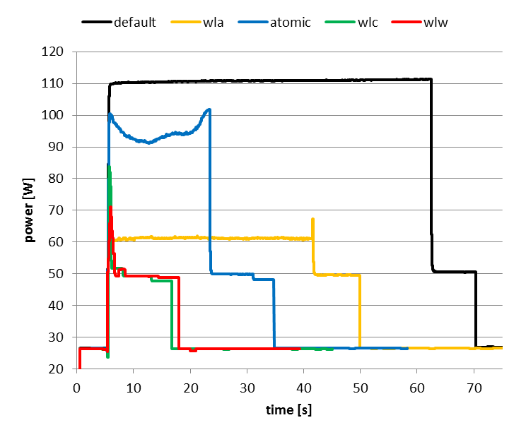
Different Implementations of BFS
WLA
Topology driven
Lowest avg power and peak power
Atomic
Fastest topology driven version
Irregular power profile
WLC and WLW
Data driven
Irregularity is masked by short runtimes
Shape of the profile depends on implementation strategy
Figure 7: Profile of different implementations of BFS
Power Characteristics of Irregular GPGPU Programs
13

Slide 14
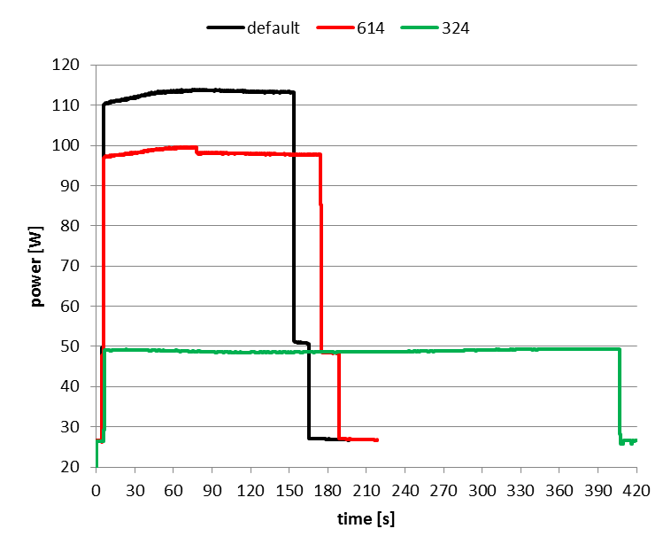
SSSP with Different Frequencies
Topology driven implementation
Same input (roadmap of USA)
Default setting
705 MHz core; 2600 MHz memory
614
614 MHz core; 2600 MHz memory
Energy stays about the same
324
324 MHz core; 324 MHz memory
Energy increases
Terrible for memory bound codes
Figure 8: Profile of SSSP on different frequencies
Power Characteristics of Irregular GPGPU Programs
14

Slide 15
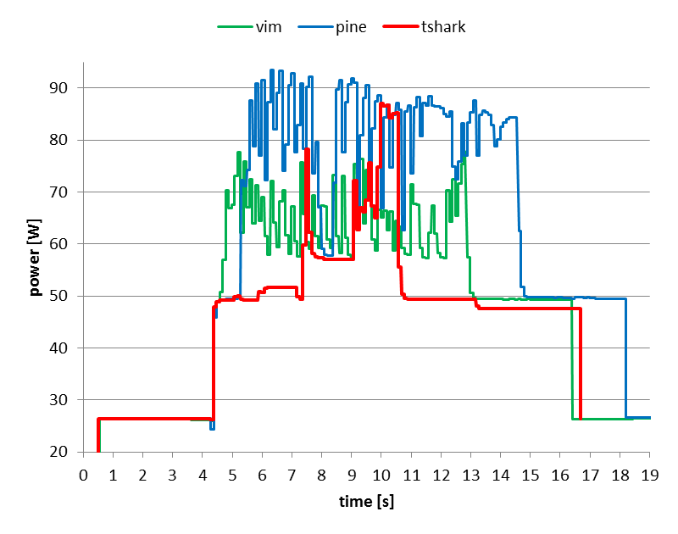
PTA with Different Inputs
Distinctly different profiles
Pine averages 15 W more than vim
Tshark has initial spike followed by a 1.5 second valley before ramping up
Pine and vim have more spikes and ramp down slightly over time
Cannot use a profile from one input to characterize the power draw over time of another
Figure 9: Profile of PTA for different inputs
Power Characteristics of Irregular GPGPU Programs
15

Slide 16
Summary
Regular codes often similar to idealized
Irregular Codes
No such thing as a standard power profile
Implementation and input can greatly affect power profile
Early behavior may not be indicative of later behavior
Cannot easily be captured by averages
Power over time
Must be considered
Re-evaluated for each input and any code modification
Provides understanding of software effects on hardware
Power Characteristics of Irregular GPGPU Programs
16

Slide 17
Questions
The work reported herein is supported by:
U.S. National Science Foundation
DUE-1141022
CNS-1217231
CNS-1406304
CCF-1438963
Texas State University
NVIDIA Corporation
Power Characteristics of Irregular GPGPU Programs
17

