Slide 1
Satisfying Bandwidth Requirements of GPU Architectures through Adaptive Wavelength Division Multiplexing
Benjamin C. Johnstone, Dr. Sonia Lopez Alarcon

Slide 2
Outline
Background
Problem Statement
Methodology
Speedup and Detailed Analyses
Results
Heterogeneous Interconnect
Bandwidth Selection Policy
Results
Conculsion

Slide 3
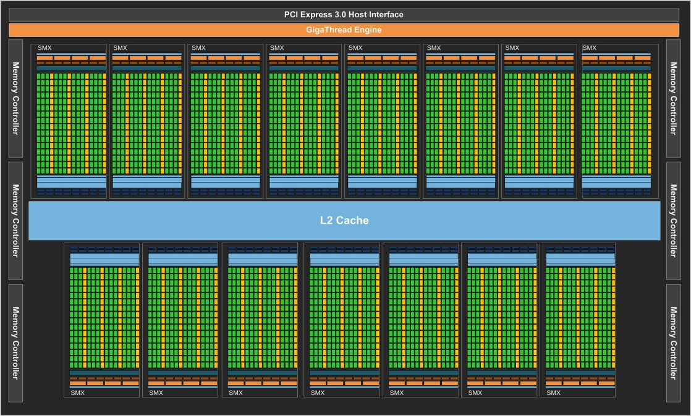
Background: GPU Architecture
Hundreds of cores
Peak performance > 1 TFLOP
High BW to DRAM
Kepler: 192 GBps
Low BW limits performance [7]
Notes:
This diagram shows an example of a GPU architecture. It has hundreds of cores organized into these blocks called SMs in CUDA terminology. Because there are so many processing elements GPUs are capable of achieving very high performance on highly parallel workloads. GPUs typically have a global memory as off chip DRAM accessed through the Memory controllers on the sides. GPUs tend to generate a lot of memory requests so the bandwidth to DRAM has to be high. Low bandwidth has been shown to be a bottleneck to performance

Slide 4
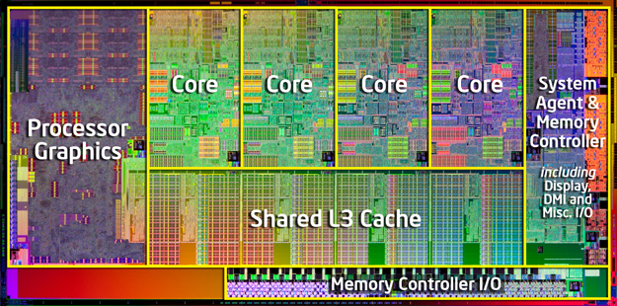
Heterogeneous CMP
CMPs with CPU and GPU cores
Intel HD Graphics
AMD APUs
Heterogeneous System Architecture
Notes:
What we’re starting to see is multiprocessors with graphics hardware built in, making them heterogeneous. This is an intel i7, you can see it has the 4 cpu cores and the graphics hardware on the left side of the chip. Expect # of both types of cores to increase, need scalable high perf. Interconnect technology. Other architectures like AMDs APUs have graphics hw which can perform general purpose applications. We expect that as transistor density increases according to Moore’s law, there will be more cores of each type. To handle this we need a scalable interconnect

Slide 5
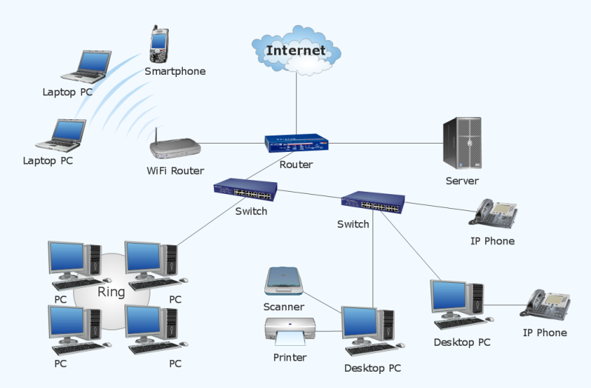
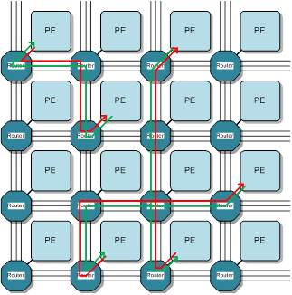
Networks on Chip
Apply computer networking to chip-level
Data broken up into packets
Flit- Flow control unit
Scalable design & performance
Notes:
GPUs don’t use NoC but are modeled as such
GPU NoC: Network with SMs and MCs as Pes

Slide 6
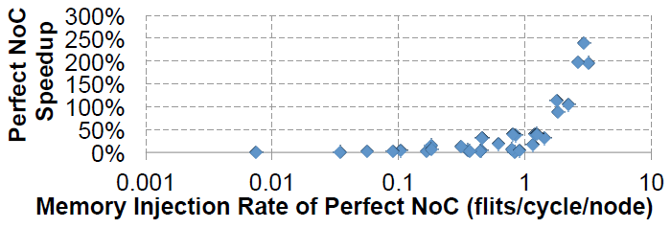
Related Work
Bakhoda, Kim, and Aamodt [2]
Performance correlated to memory injection rate
Focus on routers and topology
We focus on interconnect technology
Notes:
There has been a lot of research looking into NoCs within a GPU, connecting the SMs to MCs…

Slide 7
Problem Statement
Need to characterize GPU communication for use in heterogeneous CMP
How can we give GPUs the right BW?
Too little BW -> lower performance
Too much BW -> higher energy costs
Focus on interconnect technology

Slide 8
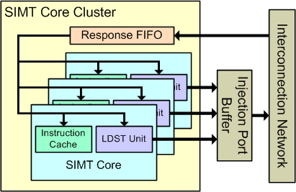
Methodology
GPGPU-Sim
Simulates PTX
Architecture analogous to GPU
Notes:
Single instruction multiple thread

Slide 9
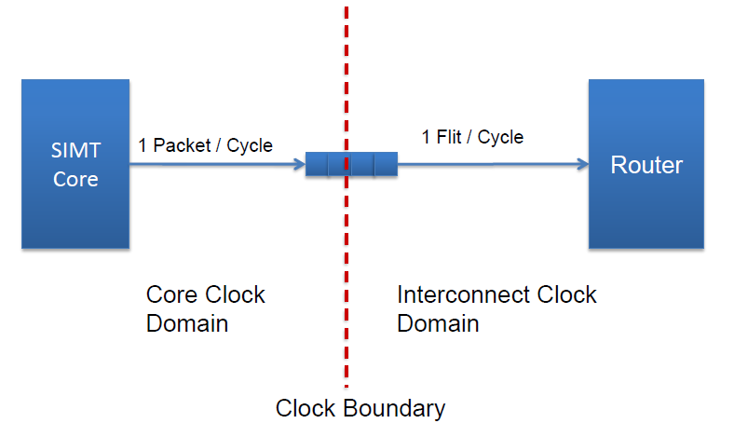
[6]

Slide 10
Experiments
GTX 480 Architecture
32 B baseline flit size
Run benchmarks with “infinite” BW
1024 B
Increase flit size incrementally
16 B to 1024 B
Detailed analysis
Other statistics from simulator
Notes:
1st experiment was to run benchmarks with a bandwidth so high that it would not limit performance. For that we chose to use a flit size of 1024
Next we increased the flit size incrementally so we could get an idea of how the performance was changing
Finally, we took the results of our simulations and looked at some of the other statistics that were generated

Slide 11
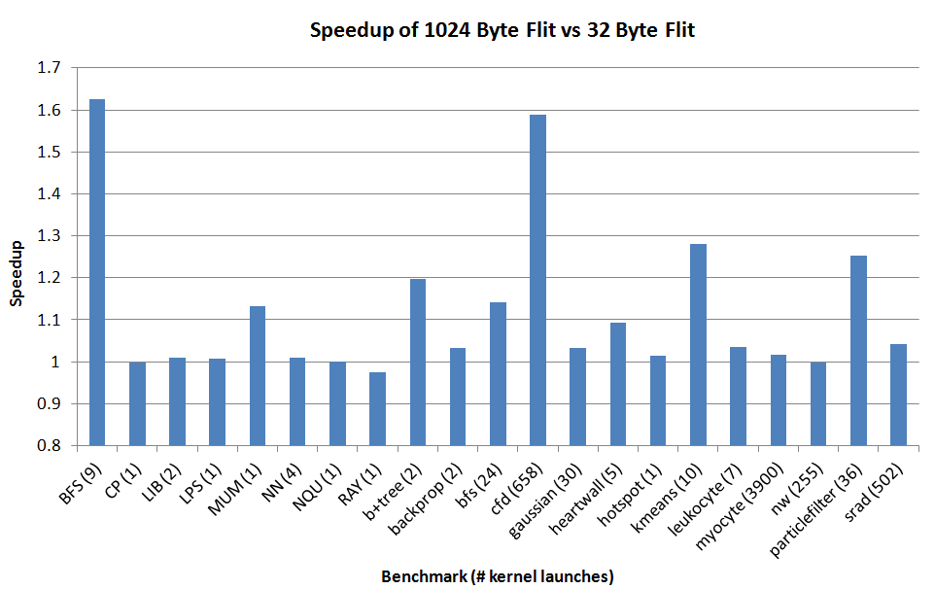
Speedup Analysis
Notes:
This graph shows the speedup of the infinite bandwidth 1024 B flit size versus the baseline. We see that Some of the benchmarks benefited, others did not.
RAY – Increased bw causes a bottleneck somewhere else

Slide 12
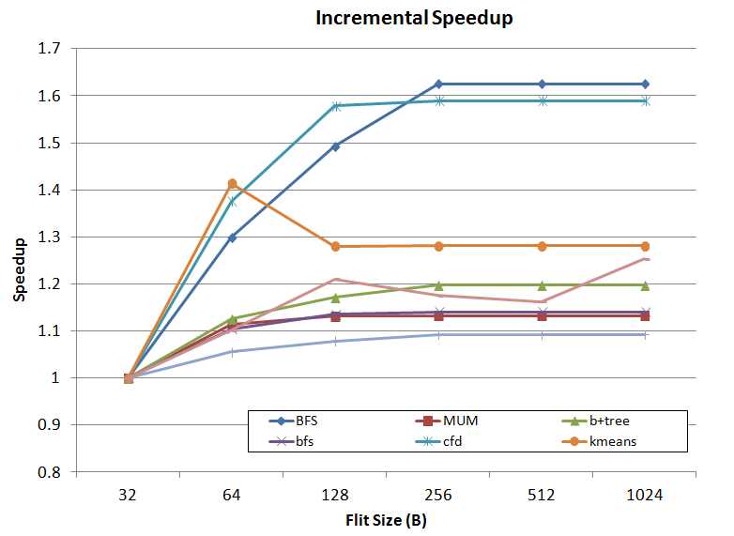
Notes:
Looking at the benchmarks that did benefit, we can see that the increase in performance levels off around 128-256B

Slide 13
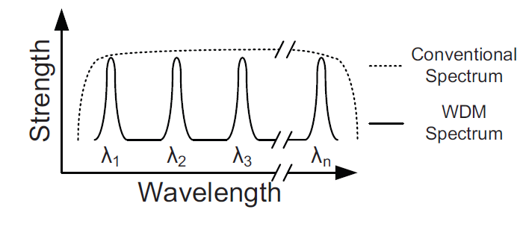
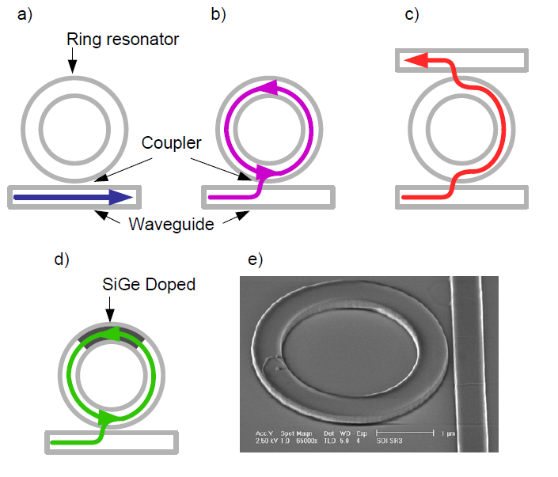
Heterogeneous NoC
Not all applications benefit from increased BW
Giving high BW to all results in wasted energy
Need an interconnect capable of providing multiple BWs
Solution: Photonic network with WDM
Vary number of wavelengths to change bandwidth
Notes:
WDM allows multiple bits to be sent in a single beam of light by encoding them into different wavelengths. The different wavelengths are picked up by these ring resonators which are sensitive to only one specific wavelength. We can change the bw by changing the number of wavelengths and resonators used.

Slide 14
Heterogeneous Photonic Interconnect Model
1 Waveguide
Supports up to 64 wavelengths
Two bandwidths
Low: 180 Gbps (18 wavelengths)
Equivalent to 32 B flit size
High: 640 Gbps (64 wavelengths)
Equivalent to 128 B flit size
Notes:
HOW DO WE CHOOSE WHICH BW TO USE?

Slide 15
Detailed Analysis
GPGPU-Sim generates statistics
Correlation between bandwidth and speedup
Predict which benchmarks will benefit
Notes:
DRAM stall: Number of cycles that the interconnect outputs to dram channel is stalled
Icnt stall: Number of cycles that the dram channels are stalled due to the interconnect congestion

Slide 16
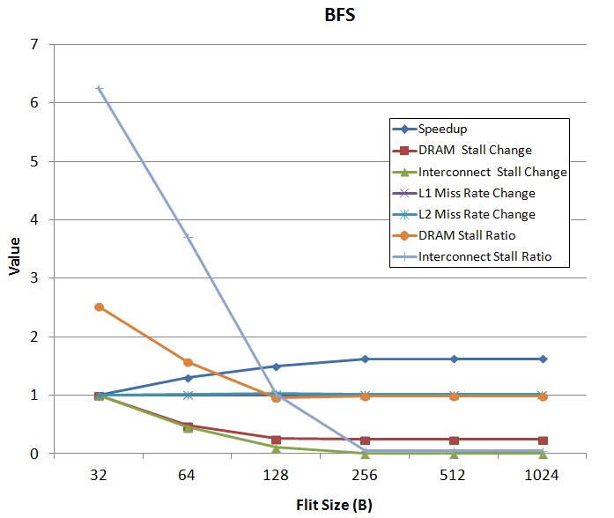
Notes:
High Interconnect stall ratio (Stalls/execution cycles) : more than one SM can generate a stall per cycle
Looking at a benchmark that improved with high bandwidth, you can see that in starting off, it has a really high ratio of icnt stalls to execution cycles. As BW increases, both types of stalls decrease resulting in better performance

Slide 17
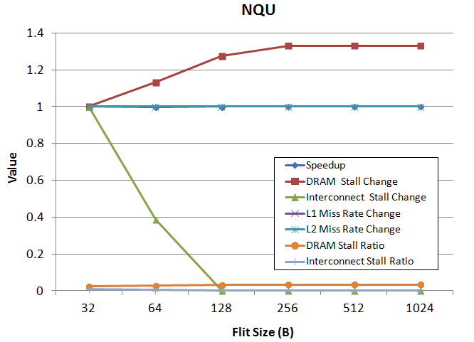
Notes:
This is a case where performance did not improve with increased bandwidth. We can see that the icnt stall ratio stays low for all BWs. In fact, as the bandwidth increases, the number of dram stalls increases, which cancels out any benefit from the decreased interconnect stalls

Slide 18
Bandwidth Selection Policy
Bakhoda, Kim, and Aamodt [6]
Speedup and memory injection rate
Choose BW based on ratio of baseline interconnect stalls to execution cycles
High ratio ( >= 0.95) uses high BW
Low ratio (< 0.95) uses low BW
Compare policy against:
Heterogeneous Photonic: optimal performance
Wired interconnects (5.5 mm, 16.25 mm, 46 mm)
Notes:
Going back to the related work I mentioned earlier, the icnt stall ratio is really a measure of the memory injection rate. So for our heterogeneous interconnect we can choose the proper bandwidth by looking at the icnt ratio in the baseline case

Slide 19
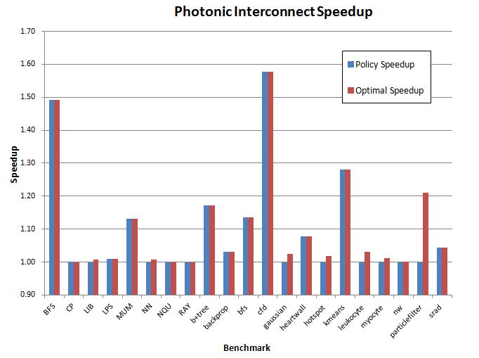
BWSP vs. Optimal Performance

Slide 20
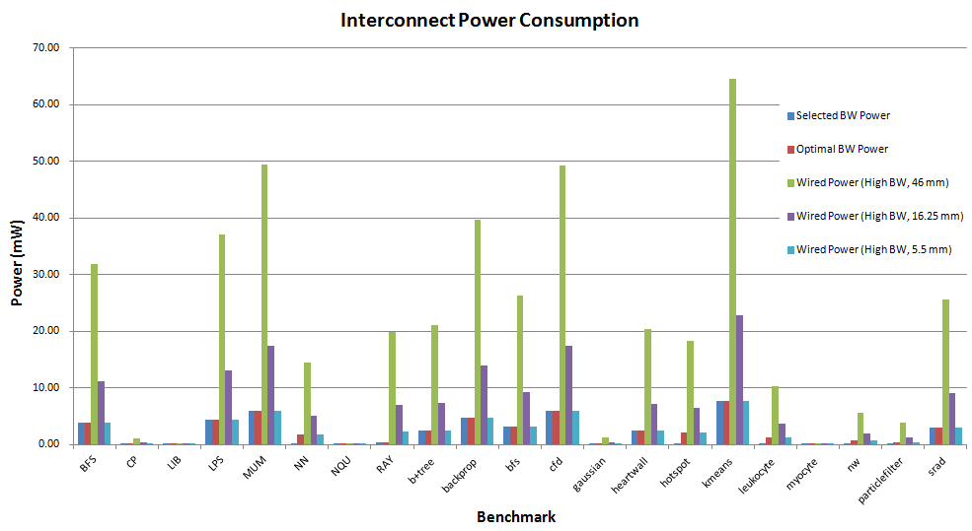
Heterogeneous Photonic vs. Wired
Notes:
This shows the power consumption for each interconnect for each benchmark. In all cases, the two longest wires are using the most power. The interconnect with our selection policy is using comparable power to the other two interconnects, except for cases when the policy chooses the low bandwidth

Slide 21
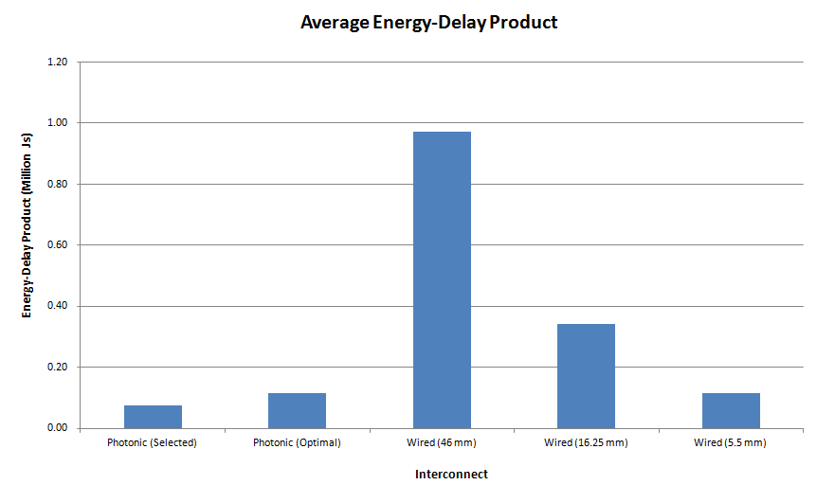
Energy-Delay Product
Notes:
EDP:measure of tradeoff between performance and energy consumption. Ideally want it to be low as possible
Here we see that when we compare the energy-delay products we see a similar story. The two longest wires use the most energy and thus have the highest EDP. The energy savings from our selection policy offset the small decrease in performance, giving it the best EDP

Slide 22
Averages
 | Speedup | Power (mJ) | Energy-delay Product
Photonic (Policy) | 1.09 | 21.43 | 76341.79
Photonic (Optimal) | 1.11 | 24.11 | 116538.77
Wired (46 mm) | 1.11 | 209.85 | 973095.84
Wired (16.25 mm) | 1.11 | 74.13 | 343756.68
Wired (5.5 mm) | 1.11 | 25.09 | 116348.42
Notes:
This essentially shows the same thing. We are able to save energy, without sacrificing too much speedup

Slide 23
Conclusions
High BW necessary, but not sufficient for optimal performance
BWSP can save energy with marginal cost to performance
Good balance between power and speedup

Slide 24
Questions?

Slide 25
Bandwidth Calculations

Slide 26
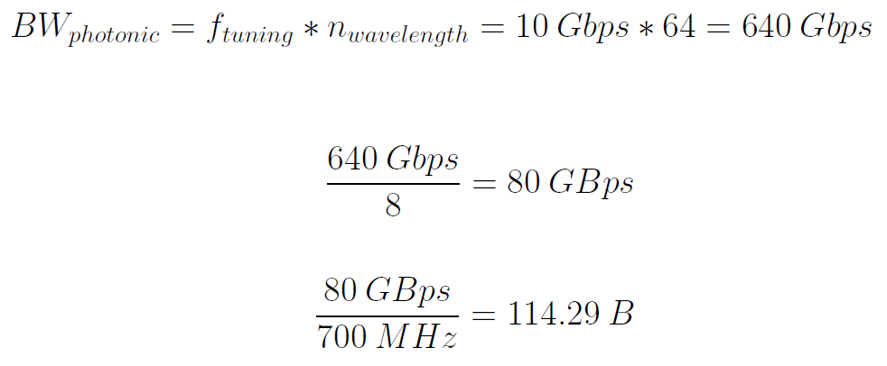
Bandwidth Calculations cont.

Slide 27
Photonic NoC
Emerging interconnect technology
Uses light to communicate between cores
Advantages
WDM: encode bits into different wavelengths
Low loss waveguides
Notes:
How big are each these compared to wires?
Resonator: 10 Gbps

Slide 28
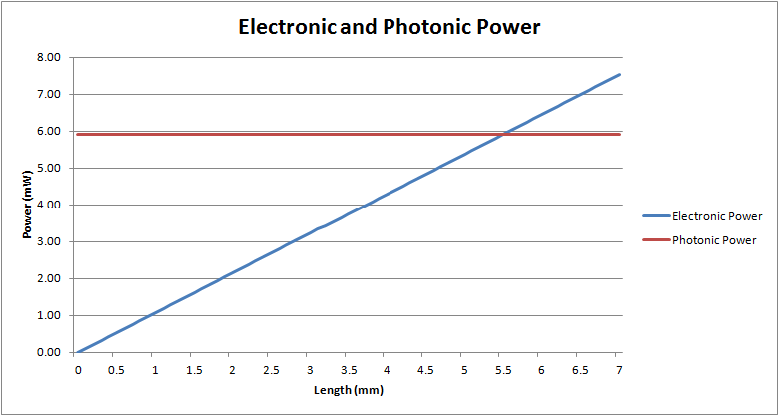
Photonic vs. Wired

Slide 29
Power model
Energy to launch bit per cycle = 0.15 pJ
Energy to modulate bit per cycle = 0.04 pJ
Energy per cycle to tune detector by 1 nm = 0.24 pJ
Notes:
Need to cite these numbers

Slide 30
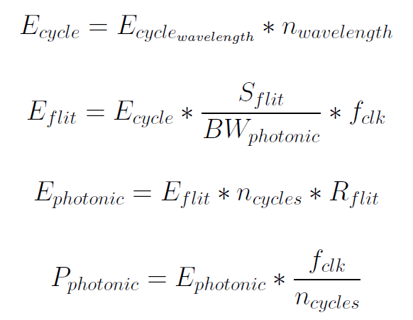
Power Model Cont.

Slide 31
Wired Test Cases
23mm x 23 mm die
46, 16.25, 5.5 mm
23 mm
23 mm
16.25 mm
46 mm
Notes:
529 mm^2

Slide 32
References
[1] A. Bakhoda, G. Yuan, W. W. L. Fung, H. Wong, T. M. Aamodt, Analyzing CUDA Workloads Using a Detailed GPU Simulator, IEEE International Symposium on Performance Analysis of Systems and Software (ISPASS), Boston, MA, April 19-21, 2009.
[2] A. Bakhoda, J. Kim, and T. M. Aamodt, Throughput-Effective On-Chip Networks for Manycore Accelerators. International Symposium on Microarchitecture, pp 421-432, Dec. 2010.
[3]C. J. Nitta, M. K. Farrens and V. Akella, On-Chip Photonic Interconnects: A Computer Architect’s Perspective. Morgan & Claypool, 2014 [E-book] Available: Morgan & Claypool Publishers.
[4] A. Flores, J. L. Aragon, and M. E. Acacio, Heterogeneous Interconnects for Energy-Efficient Message Management in CMPs. IEEE Transactions on Computers, Vol. 59, Issue 1, Jan. 2010
[5] H. Kim, J. Kim, W. Seo, Y. Cho and S. Ryu, Providing Cost-effective On-Chip Network Bandwidth in GPGPUs. International Conference on Computer Design, pp 407-412, Sept. 2012.
[6] T. M. Aamodt, W. W. L. Fung and A. Boktor, GPGPU-Sim 3.x: A Performance Simulator for Many-Core Accelerator Research. MICRO 2012.
[7] Z. Guz, E. Bolotin, I. Keidar, A. Kolodny, A. Mendelson, and U. C. Weiser, Many-Core vs. Many-Thread Machines: Stay Away From the Valley. IEEE Computer Architecture Letters, Vol. 8, No. 1, Jan. 2009.
[8] K. Preston, N. Sherwood-Droz, J. Levy, and M. Lipson, “Performance guidelines for WDM interconnects based on silicon microring resonators,” Conference on Lasers and Electro-Optics, May 2011.
[9] P. Dong, S. Liao, D. Feng, H. Liang, R. Shafiiha, N. Feng, G. Li, X. Zeng, A. Krishnamoorthy, and M. Asghari, “Tunable high speed silicon microring modulator,” CLEO and QELS, May 2010.

