Slide 1
GreenSched: An Energy-Aware Hadoop Workflow Scheduler
Krish K. R. † , M. Safdar Iqbal† , M. Mustafa Rafique‡
† Distributed Systems and Storage Lab, Virgnia Tech
‡IBM Research, Ireland

Slide 2
Hadoop has become the de facto bigdata processing framework!
Yahoo! : 40,000 nodes running Hadoop Google : 20 PB of data/day
Facebook : 3000 jobs/day
Notes:
DSFs such as Hadoop/MapReduce have become synonymous with Bigdata. Several key industry players in Bigdata use these DSFs and DSFs that need this.

Slide 3
An overview of Hadoop architecture
Job
Master Node
Client
Scalability
Reliability
JobTracker
Job
Job
Homogeneity
Output
Output
Slave Node
Slave Node
Slave Node
TaskTracker
TaskTracker
TaskTracker
Fault Tolerance
Simplicity of management
Task
Task
Task
Task
Task
Task
HDFS
Data
Node
Data
Node
Data
Node
HDFS - Hadoop Distributed File System.
Notes:
Hadoop has become the defacto platform for the bigdata, and is been used extensively by FB, Yahoo! To process large amount of data.
Typically Hadoop jobs are batch processed and the performance mostly dependents on Performance of the Storage

Slide 4
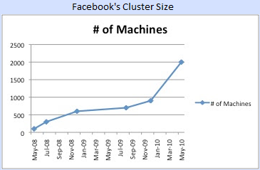
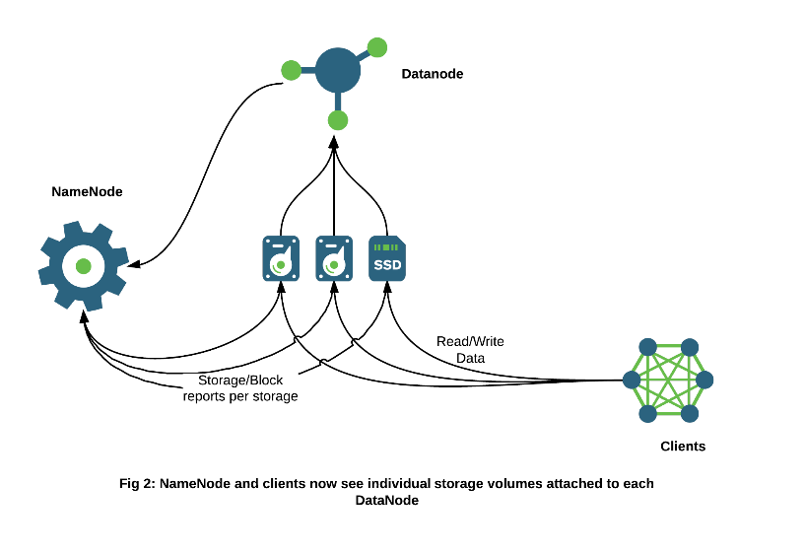
Heterogeneity is inevitable
Emergence of specialized architectures such as GPUs, FPGAs, micro-servers, SSDs and customized SAN/NAS
Regular system upgrades
Heterogeneity is not an exception but the norm in large data centers
Optimizing Hadoop for Microservers – Hortonworks
Heterogeneous Storages in HDFS– Hortonworks

Slide 5
Goal
Design a workflow management system to effectively schedule jobs to multiple heterogeneous clusters while considering the power and performance goals
Study the power characteristics of Hadoop applications and perform power-conserving job scheduling for Hadoop

Slide 6
Enabling Technology: ΦSched: Heterogeneity aware Hadoop workflow scheduler
Workflow
Manager
File
a
Job 1
1
2
3
Job
Tracker
Job
Tracker
Job 2
1
2
3
Optimize
placement / retrieval
to be region aware
Master
Slave
nodes
1
3
2
2
1
3
a
Cluster 1
Cluster 2
Map Slot
DataNode
Notes:
To this end we propose, decoupling storage and compute…

Slide 7
Design of GreenSched
ΦSched invokes Cluster Manager to compute the expected execution times
Cluster Manager consults the Execution Predictor to return a sorted list of optimal clusters
ΦSched uses the list and the enhanced HDFS APIs to schedule a job
Energy Profiler track power usage characteristics of the applications on a particular hardware
Job Queue
ΦSched
Cluster Manager
HDFS
APIs
Energy Profiler
Exec. Predictor
Compute Substrate
Compute Substrate
Compute Substrate
Storage Substrate
Storage Substrate
Storage Substrate
Different Heterogeneous Configurations
Notes:
Static and dynamic profilg are don using SAR tool.

Slide 8
Execution Predictor
Maintains a catalog of job execution histories
Profiles the job statically and dynamically fine tune the profile of the job
Determines expected execution time and the required resources for submitted jobs

Slide 9
Cluster Manager
Manages all the clusters in a deployment
Profiles and predicts the utilization of resources
Tracks the load as jobs assigned to the clusters
Balances load in the cluster

Slide 10
HDFS enhancement
Provides APIs to move / prefetch data across regions
Ensures data availability / data mobility across multiple clusters
Associates each DataNode with an unique ‘region’
Identifies all DataNodes in a cluster (of clusters) with the same region
Proposes ‘region-aware’ placement and retrieval policy

Slide 11
Energy Profiler
Tracks, records and analyzes the power usage characteristics of the application on a particular hardware.
Computes performance to power ratio for different jobs in each cluster
Schedules the job to the cluster with least performance to power ratio

Slide 12
Evaluation testbed
Three clusters each containing 5 homogeneous nodes
Name | CPUs | RAM (GB) | Storage (GB) | Network | Map Slots | Reduce slots
Cluster 1 | 8 | 8 | SSD | 1 Gbps | 4 | 2
Cluster 2 | 2 | 2 | HDD | 128 Mbps | 2 | 2
Cluster 3 | 16 | 16 | HDD | 10 Gbps | 8 | 4

Slide 13
Performance of applications on different clusters
Notes:
We observe the overall I/O throughput across map tasks and the average I/O rate calculated as the average of the throughputs achieved per map task.

Slide 14
Power consumption of applications on different clusters
Notes:
We observe the overall I/O throughput across map tasks and the average I/O rate calculated as the average of the throughputs achieved per map task.

Slide 15
Performance comparison of Cluster 1 Vs Cluster 2
Notes:
We observe the overall I/O throughput across map tasks and the average I/O rate calculated as the average of the throughputs achieved per map task.

Slide 16
Power consumption comparison of Cluster 1 Vs Cluster 2
Notes:
We observe the overall I/O throughput across map tasks and the average I/O rate calculated as the average of the throughputs achieved per map task.

Slide 17
Comparison of performance to power ratio
No single ‘Best’ cluster for all workload

Slide 18
Overall performance of GreenSched
GreenSched achieves 12.8% performance improvement and 21% reduction in power consumption over hardware-oblivious policies

Slide 19
Conclusion: GreenSched enables power-aware Hadoop scheduler
Exploits heterogeneity to perform power-aware hardware Hadoop scheduler
Provides APIs for effective data management
Realizes significant performance benefits
12.8% increase in execution time
21% less power

Slide 20
QUESTIONS

