Slide 1


A High-Performance Connected Components Implementation for GPUs
Jayadharini Jaiganesh and Martin Burtscher

Slide 2
Connected Components (CCs)
A CC of an undirected graph G = (V, E)
  Subset: S ⊆ V such that ∀a, b ∈ S: ∃a↝b
  Maximal: ∀a ∈ S, b ∈ V \ S: ∄a↝b
Connected-components algorithm
  Identifies all such subsets
  Labels each vertex with unique ID of component
b
b
a
f
a
f
d
d
c
e
c
e
g
g

Slide 3
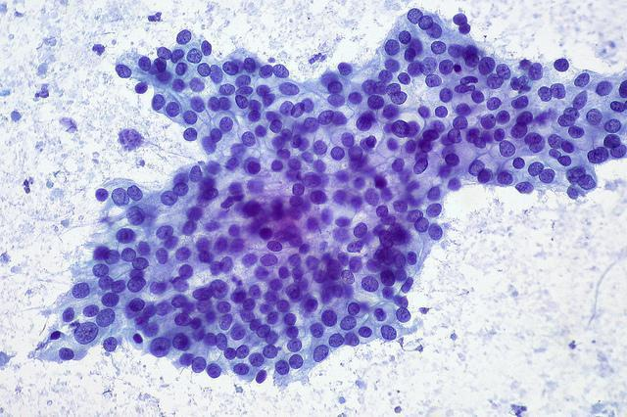
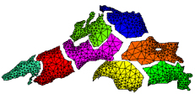
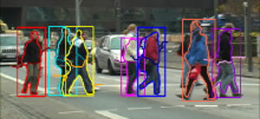
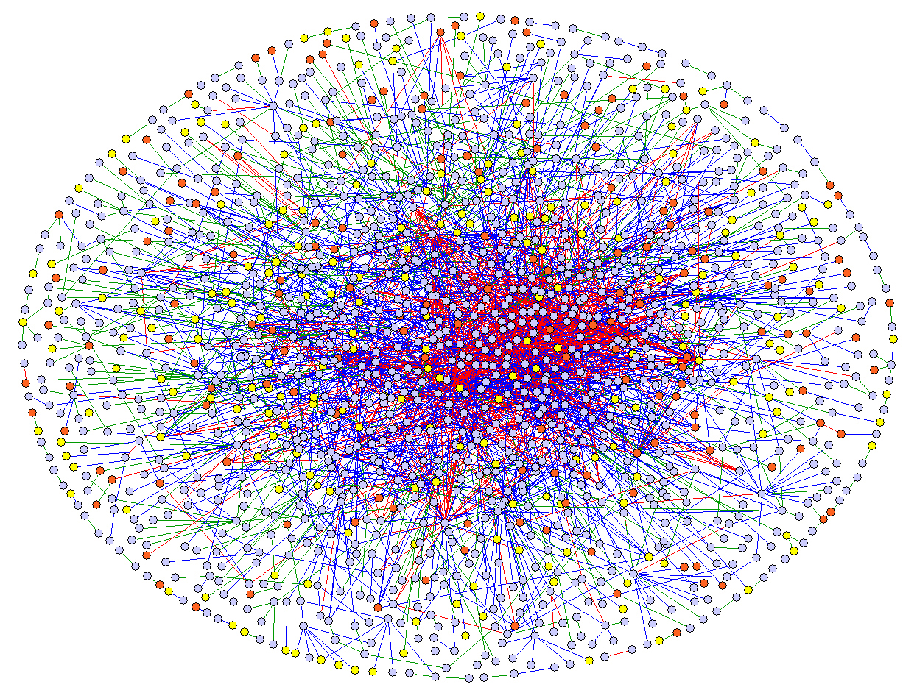
Applications and Importance
Important graph algorithm
  Medicine: cancer and tumor detection
  Computer vision: object detection
  Biochemistry: drug discovery and protein genomics
  Also used in other graph algorithms, e.g., partitioning
Fast (parallel) CC implementation
  Can speed up these and other important computations

Slide 4
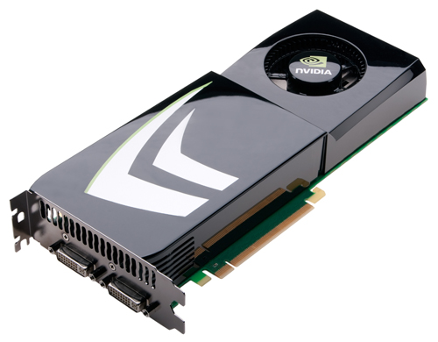
Highlights
Our ECL-CC GPU Implementation
  Builds upon the best ideas from prior work
  Combines them with key GPU optimizations
  Asynchronous, lock free, employs load balancing, visits each edge once, only processes edges in one direction
Faster than fastest prior GPU and CPU codes
  1.8x over GPU code, 19x over multicore CPU code
  Faster on most tested graphs, especially on large graphs

Slide 5
Prior CC Algorithms

Slide 6
Serial CC Algorithm
b
Unmark all vertices
Visit them in any order
If visited vertex is unmarked
  Use it as source of DFS or BFS
  Mark all reached vertices
  Set their labels to ID of source
Takes O(|V|+|E|) time
a
f
d
c
e
g
b
a
f
d
c
e
b
g
a
f
d
c
e
g
b
a
f
d
c
e
g

Slide 7
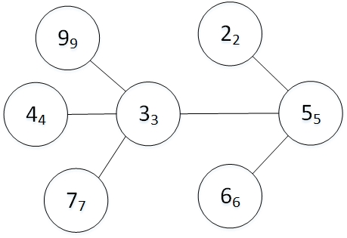
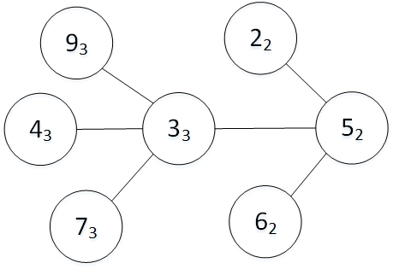
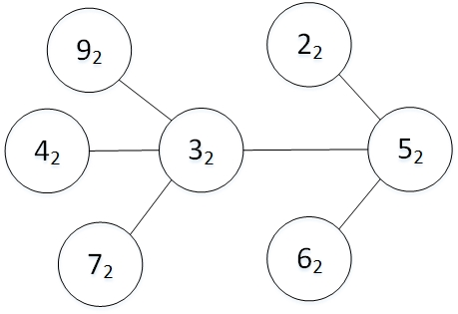
Alternate CC Algorithm
Based on label-propagation approach
  Set each label (subscripts) to unique vertex ID
  Propagate labels through edges (e.g., keep minimum)
  Repeat until no more changes
  (Can be accelerated with union-find data structure)
label
propagation
label
propagation

Slide 8
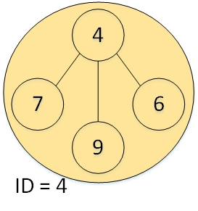
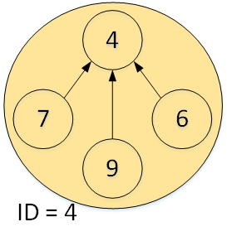
Parallel CC Algorithms
Based on serial algorithm but with parallel BFS
Shiloach & Vishkin’s algorithm
  Components are represented by tree data structure
    Root ID serves as component ID
  Initially, each vertex is a separate tree
    Component labelled by its own ID
  Iterates over two operations
    Hooking
    Pointer jumping

Slide 9
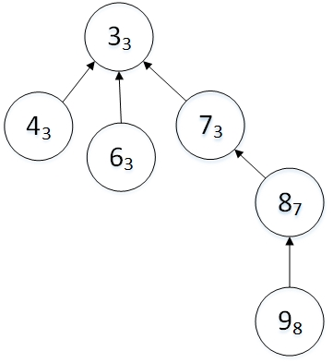
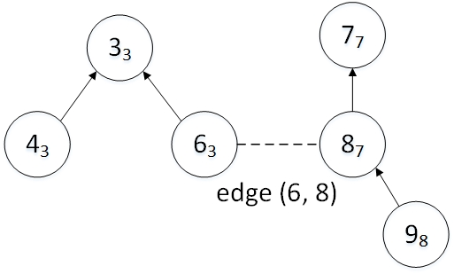
Hooking
Processes edges (of original graph)
Combines trees at either end of edge
  For each edge (u, v), checks if u and v have same label
  If not, link higher label to lower label
hooking

Slide 10
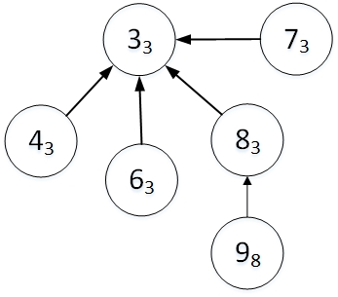
Pointer Jumping (PJ)
Processes vertex labels (edges of the trees)
Shortens path to root
  Replaces a vertex’s label with its parent’s label
  Reduces depth of tree by one
pointer
jumping

Slide 11
Other (Single) PJ-based Algorithms
CRONO (CPU)
  Implements Shiloach and Vishkin’s algorithm
  Stores graph in 2D matrices of size n * d_{max}
    d_{max} is the graph’s maximum degree
  Simple and fast but inefficient memory usage for graphs with high-degree vertices
    Runs out of memory on some of our graphs

Slide 12
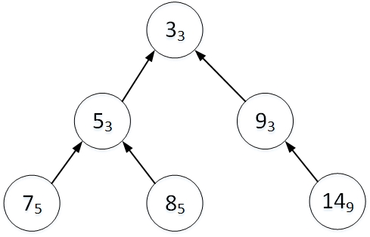
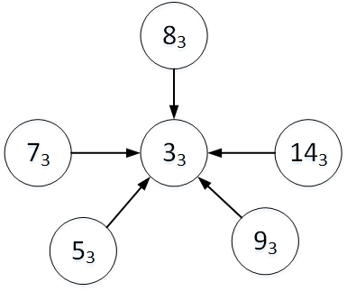
Multiple Pointer Jumping
Soman’s implementation (GPU)
  Variant of Shiloach-Vishkin’s algorithm
Uses multiple pointer jumping
  Replaces a vertex’s label with root’s label
  Reduces depth of tree to one
multiple pointer jumping

Slide 13
Other Multiple PJ-based Algorithms
IrGL (GPU)
  Automatically synthesized from high-level specification
Gunrock (GPU)
  Reduces workload after each iteration through filtering
    Removes completed edges and vertices from consideration
Groute (GPU)
  Splits edge list of graph into multiple segments
  Performs hooking and PJ one segment at a time
  Uses atomic hooking, eliminates need for iteration

Slide 14
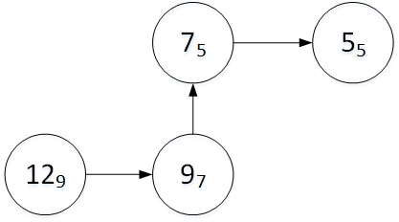
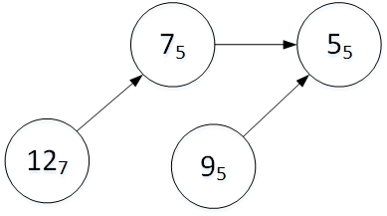
Other PJ-based Algorithms
Galois (CPU)
  Runs asynchronously using a restricted form of PJ
  Visits each edge exactly once & in one direction only
Patwary, Refsnes, and Manne’s approach
  Employs intermediate pointer jumping (path halving)
  Skips next node, reduces depth of tree by factor of 2
intermediate
pointer jumping

Slide 15
Parallel BFS-based Algorithms
Ligra+ BFSCC (CPU)
  Based on Ligra’s parallel BFS implementation
  Internally uses a compressed graph representation
Multistep (CPU)
  Performs single BFS rooted in the vertex with d_{max}
  Performs label propagation on remaining subgraph
ndHybrid (CPU)
  Runs concurrent BFSs to create low-diameter partitions
  Contracts each partition into single vertex, then repeats

Slide 16
ECL-CC: Our Implementation

Slide 17
ECL-CC
Combines prior ideas in new and unique way
  Based on label propagation (with union-find)
  Employs intermediate pointer jumping
  Visits each edge exactly once & in one direction only
  No iteration (fully interleaves hooking and PJ)
  Is asynchronous, lock-free, and recursion-free
Other features
  Does not need to mark or remove edges
  CPU code requires no auxiliary data structure

Slide 18
ECL-CC Implementation (3 Phases)
Initialization
  Determines initial label values
Computation
  Performs hooking and pointer jumping
    Hooking code is lock-free (may execute atomicCAS)
    PJ code is atomic-free, re-entrant, and has good locality
      Also useful for other union-find-based GPU (and CPU) codes
Finalization
  Computes final label values (shortens path lengths to 1)

Slide 19
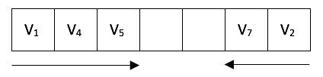

ECL-CC Versions
GPU code
  Uses 3 compute kernels for load balancing
    K1: thread-based processing for d(v) ≤ 16
      Puts larger vertices on double-sided worklist
    K2: warp-based processing for 16 < d(v) ≤ 352
    K3: block-based processing for d(v) > 352
  http://cs.txstate.edu/~burtscher/research/ECL-CC/
CPU code (ported from GPU code)
  OpenMP and serial: no worklist & other simplifications
16 < d(v) $≤$ 352
d(v) > 352

Slide 20
Results

Slide 21
Methodology: 2 Devices and 17 Codes
1.1 GHz Titan X GPU
  3072 cores, 49152 threads
  2 MB L2, 12 GB (336 GB/s)
3.1 GHz dual Xeon CPU
  20 cores, 40 threads
  25 MB L3, 128 GB (68 GB/s)
Two more devices in paper
Comparison
  5 GPU codes
  7 parallel CPU codes
  5 serial CPU codes
Device | Ser/Par | Name | Version
GPU | parallel | ECL-CC | 1.0
 |  | Groute
 |  | Gunrock
 |  | IrGL
 |  | Soman
CPU | parallel | CRONO | 0.9
 |  | ECL-CC_{OMP} | 1.0
 |  | Galois | 2.3.0
 |  | Ligra+ BFSCC
 |  | Ligra+ Comp
 |  | Multistep
 |  | ndHybrid
CPU | serial | Boost | 1.62.0
 |  | ECL-CC_{SER} | 1.0
 |  | Galois | 2.3.0
 |  | igraph
 |  | Lemon | 1.3.1

Slide 22
Methodology: 18 Input Graphs
Graph name | Type | Origin | Vertices | Edges* | d_{min} | d_{avg} | d_{max} | CCs
2d-2e20.sym | grid | Galois | 1,048,576 | 4,190,208 | 2 | 4.0 | 4 | 1
amazon0601 | co-purchases | SNAP | 403,394 | 4,886,816 | 1 | 12.1 | 2,752 | 7
as-skitter | Int. topology | SNAP | 1,696,415 | 22,190,596 | 1 | 13.1 | 35,455 | 756
citationCiteseer | pub. citations | SMC | 268,495 | 2,313,294 | 1 | 8.6 | 1,318 | 1
cit-Patents | pat. citations | SMC | 3,774,768 | 33,037,894 | 1 | 8.8 | 793 | 3,627
coPapersDBLP | pub. citations | SMC | 540,486 | 30,491,458 | 1 | 56.4 | 3,299 | 1
delaunay_n24 | triangulation | SMC | 16,777,216 | 100,663,202 | 3 | 6.0 | 26 | 1
europe_osm | road map | SMC | 50,912,018 | 108,109,320 | 1 | 2.1 | 13 | 1
in-2004 | web links | SMC | 1,382,908 | 27,182,946 | 0 | 19.7 | 21,869 | 134
internet | Int. topology | SMC | 124,651 | 387,240 | 1 | 3.1 | 151 | 1
kron_g500-logn21 | Kronecker | SMC | 2,097,152 | 182,081,864 | 0 | 86.8 | 213,904 | 553,159
r4-2e23.sym | random | Galois | 8,388,608 | 67,108,846 | 2 | 8.0 | 26 | 1
rmat16.sym | RMAT | Galois | 65,536 | 967,866 | 0 | 14.8 | 569 | 3,900
rmat22.sym | RMAT | Galois | 4,194,304 | 65,660,814 | 0 | 15.7 | 3,687 | 428,640
soc-LiveJournal1 | j. community | SNAP | 4,847,571 | 85,702,474 | 0 | 17.7 | 20,333 | 1,876
uk-2002 | web links | SMC | 18,520,486 | 523,574,516 | 0 | 28.3 | 194,955 | 38,359
USA-road-d.NY | road map | Dimacs | 264,346 | 730,100 | 1 | 2.8 | 8 | 1
USA-road-d.USA | road map | Dimacs | 23,947,347 | 57,708,624 | 1 | 2.4 | 9 | 1

Slide 23
ECL-CC Initialization (1st Label Values)
Vertex’s own ID may be poor starting value
Determining smallest neighbor ID is too costly
Using vertex’s own ID requires no mem access
Use 1st smaller neighbor
Little extra work and better starting value
Smallest neighbor ID
Vertex’ own ID
First smaller neighbor ID

Slide 24
ECL-CC Computation (PJ)
Intermediate PJ is superior
PJ is important
Two traversals are expensive
Shortens entire path in just one traversal
Only shortening one element isn’t enough
Single PJ
No PJ
Multiple PJ
Intermediate PJ

Slide 25
ECL-CC L2 Cache Accesses
Runtime correlates with read accesses
Multiple PJ causes many L1 misses
Intermediate PJ has best locality
No PJ requires long traversals
Single PJ has bad write locality
Single PJ has good read locality
Multiple PJ causes many L1 misses
No PJ performs fewest writes
Multiple PJ
Single PJ
No PJ

Slide 26
ECL-CC Finalization
Multiple PJ performs too many memory accesses
Little difference between intermediate and single PJ
Use single PJ for simplicity
Multiple PJ
Intermediate PJ
Single PJ

Slide 27
ECL-CC Kernel Runtime Distribution
Finalization takes 5.7%
Speeding up the computation is key
Computation takes 84.5% (47.1%, 26.5%, 10.9%)
Initialization takes 9.8%

Slide 28
Performance Comparison

Slide 29
GPU Runtime Comparison
ECL-CC performs very well
Groute is faster in two cases

Slide 30
GPU Runtimes in Milliseconds
Graph name | ECL-CC | Groute | Gunrock | IrGL | Soman
2d-2e20.sym | 1.2 | 1.9 | 12.2 | 11.6 | 6.9
amazon0601 | 0.9 | 0.9 | 3.1 | 6.5 | 1.5
as-skitter | 2.5 | 2.0 | 8.1 | 5.4 | 3.7
citationCiteseer | 0.6 | 4.2 | 4.4 | 6.9 | 2.1
cit-Patents | 14.6 | 58.6 | 104.6 | 70.9 | 67.6
coPapersDBLP | 2.5 | 2.8 | 20.1 | 11.9 | 7.3
delaunay_n24 | 14.6 | 22.1 | 170.6 | 62.2 | 66.7
europe_osm | 29.0 | 21.7 | 256.9 | 99.5 | 116.8
in-2004 | 2.6 | 7.3 | 75.7 | 15.4 | 12.1
internet | 0.2 | 0.3 | 2.6 | 5.2 | 1.6
kron_g500-logn21 | 20.9 | 24.6 | 191.8 | 141.0 | 134.5
r4-2e23.sym | 21.6 | 23.8 | 67.6 | 54.6 | 53.8
rmat16.sym | 0.3 | 1.7 | 1.8 | 4.1 | 1.1
rmat22.sym | 20.5 | 126.1 | 129.9 | 109.5 | 102.4
soc-LiveJournal1 | 12.7 | 14.0 | 60.4 | 43.1 | 41.3
uk-2002 | 45.8 | 108.5 | 1,389.1 | 243.8 | 229.7
USA-road-d.NY | 0.2 | 0.3 | 2.7 | 7.6 | 1.6
USA-road-d.USA | 14.1 | 15.3 | 168.0 | 60.4 | 67.1
Shortest ECL-CC time is 1/5000 sec.
10 edges per clock
Longest ECL-CC time is 1/22 sec.
295 cycles per edge
Over 11 billion edges per second

Slide 31
Parallel CPU Runtime Comparison
However…
ECL-CC_{OMP} faster than most on avg.
Many cases where ECL-CC_{OMP} is beat
On average, ndHybrid performs on par

Slide 32
CPU Runtime Sorted by Graph Size
ECL-CC_{OMP} performs well
Other codes mostly faster on smaller graphs
ECL-CC_{OMP} faster on larger graphs

Slide 33
Serial CPU Runtime Comparison
ECL-CC_{SER} also performs very well
ECL-CC_{SER} slower on two small graphs

Slide 34
Runtime Relative to ECL-CC (GPU)
Parallel CPU codes are 19x slower
GPU codes are almost 2x slower
Serial CPU codes are 77x slower
ECL-CC is the fastest tested CC code

Slide 35
Summary and Conclusion
ECL-CC performance
  Outperforms all other tested codes by large margin
  On most tested graphs and especially on large graphs
Intermediate pointer jumping implementation
  Path compression in union-find data structures
  Parallelism friendly and good locality
Conclusion
  ECL-CC can speed up important CC & union-find codes
  May lead to faster tumor detection, drug discovery, etc.

Slide 36
Thank you!
Acknowledgments
  Sahar Azimi, NSF, Nvidia, reviewers
Contact information
  burtscher@txstate.edu
Web page (link to paper and source code)
  http://cs.txstate.edu/~burtscher/research/ECL-CC/

