Slide 1
A High-Quality and Fast Maximal Independent Set Algorithm for GPUs
Martin Burtscher and Sindhu Devale
Department of Computer Science

Slide 2
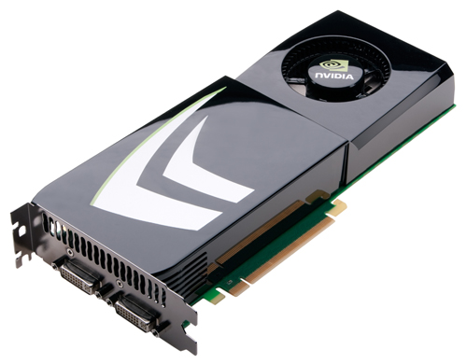
Overview
Introduction
Serial and parallel algorithms
Our parallel algorithm
Optimizations
Results
Summary

Slide 3
Maximal Independent Set
Maximal independent set (MIS)
Subset of vertices of undirected graph
Vertices in subset are independent (not adjacent)
Subset is maximal (all other vertices are adjacent)
Not unique
Largest possible MIS
Maximum independent set
NP-hard to compute
a
b
c
d
e
f
g
h
i

Slide 4
Importance of MIS
Building block of many parallel graph algorithms
Graph coloring
Maximal matching
2-satisfiability
Maximal set packing
Odd set cover problem
etc.
a
b
c
d
e
f
g
h
i

Slide 5
Importance of MIS (cont.)
Parallelization of complex computations
Supports arbitrary and dynamically changing conflicts
Build graph (vertices = computations, edges = conflicts)
Compute MIS
Run computations in MIS in parallel (w/o locks or atomics)
Repeat if necessary
E.g., Delaunay mesh refinement
Approach is only useful if MIS can be computed quickly in parallel and benefits from large sets

Slide 6
Highlights
ECL-MIS algorithm for massively-parallel devices
Fastest MIS runtimes on modern GPUs
Randomized permutation selection function
Largest set sizes among many MIS algorithms
New optimizations
Enhance performance and reduce memory footprint

Slide 7
Serial Algorithm

Slide 8
Serial Algorithm
Repeating steps
Visit unvisited vertex
Add vertex to set if no graph neighbors in set
Example
Start with empty set
Set = {}
a
b
c
d
e
f
g
h
i

Slide 9
Serial Algorithm
Repeating steps
Visit unvisited vertex
Add vertex to set if no graph neighbors in set
Example
a has no neighbor in set
Add vertex a
Set = {a}
a
b
c
d
e
f
g
h
i

Slide 10
Serial Algorithm
Repeating steps
Visit unvisited vertex
Add vertex to set if no graph neighbors in set
Example
b has neighbor in set
Discard vertex b
Set = {a}
a
b
c
d
e
f
g
h
i

Slide 11
Serial Algorithm
Repeating steps
Visit unvisited vertex
Add vertex to set if no graph neighbors in set
Example
c has neighbor in set
Discard vertex c
Set = {a}
a
b
c
d
e
f
g
h
i

Slide 12
Serial Algorithm
Repeating steps
Visit unvisited vertex
Add vertex to set if no graph neighbors in set
Example
d has neighbor in set
Discard vertex d
Set = {a}
a
b
c
d
e
f
g
h
i

Slide 13
Serial Algorithm
Repeating steps
Visit unvisited vertex
Add vertex to set if no graph neighbors in set
Example
e has no neighbor in set
Add vertex e
Set = {a, e}
a
b
c
d
e
f
g
h
i

Slide 14
Serial Algorithm
Repeating steps
Visit unvisited vertex
Add vertex to set if no graph neighbors in set
Example
f has neighbor in set
Discard vertex f
Set = {a, e}
a
b
c
d
e
f
g
h
i

Slide 15
Serial Algorithm
Repeating steps
Visit unvisited vertex
Add vertex to set if no graph neighbors in set
Example
g has neighbor in set
Discard vertex g
Set = {a, e}
a
b
c
d
e
f
g
h
i

Slide 16
Serial Algorithm
Repeating steps
Visit unvisited vertex
Add vertex to set if no graph neighbors in set
Example
h has no neighbor in set
Add vertex h
Set = {a, e, h}
a
b
c
d
e
f
g
h
i

Slide 17
Serial Algorithm
Repeating steps
Visit unvisited vertex
Add vertex to set if no graph neighbors in set
Example
i has neighbor in set
Discard vertex i
MIS = {a, e, h}
a
b
c
d
e
f
g
h
i

Slide 18
Luby’s Random-Priority Parallel MIS Algorithm

Slide 19
Random-Priority Algorithm (Luby)
Repeating steps
Assign random priorities
Add vertices with highest local priority to set
Remove their neighbors from graph
Set = {}
a
b
c
d
e
f
g
h
i

Slide 20
Random-Priority Algorithm (Luby)
Repeating steps
Assign random priorities
Add vertices with highest local priority to set
Remove their neighbors from graph
Set = {}
a₅
b₇
c₁
d₄
e₆
f₃
g₄
h₃
i₂

Slide 21
Random-Priority Algorithm (Luby)
Repeating steps
Assign random priorities
Add vertices with highest local priority to set
Remove their neighbors from graph
Set = {b, e}
a₅
b₇
c₁
d₄
e₆
f₃
g₄
h₃
i₂

Slide 22
Random-Priority Algorithm (Luby)
Repeating steps
Assign random priorities
Add vertices with highest local priority to set
Remove their neighbors from graph
Set = {b, e}
a
b
c
d
e
f
g
h
i

Slide 23
Random-Priority Algorithm (Luby)
Repeating steps
Assign random priorities
Add vertices with highest local priority to set
Remove their neighbors from graph
Set = {b, e}
a
b
c₉
d
e
f
g
h₅
i₆

Slide 24
Random-Priority Algorithm (Luby)
Repeating steps
Assign random priorities
Add vertices with highest local priority to set
Remove their neighbors from graph
Set = {b, c, e, i}
a
b
c₉
d
e
f
g
h₅
i₆

Slide 25
Random-Priority Algorithm (Luby)
Repeating steps
Assign random priorities
Add vertices with highest local priority to set
Remove their neighbors from graph
MIS = {b, c, e, i}
a
b
c
d
e
f
g
h
i

Slide 26
Random-Permutation Parallel MIS Algorithm

Slide 27
Random-Permutation Algorithm
Initialization
Assign random priorities
Repeating steps
Add vertices with highest local priority to set
Remove neighbors and their edges from graph
Set = {}
a
b
c
d
e
f
g
h
i

Slide 28
Random-Permutation Algorithm
Initialization
Assign random priorities
Repeating steps
Add vertices with highest local priority to set
Remove neighbors and their edges from graph
Set = {}
a₅
b₇
c₁
d₄
e₆
f₃
g₄
h₃
i₂

Slide 29
Random-Permutation Algorithm
Initialization
Assign random priorities
Repeating steps
Add vertices with highest local priority to set
Remove neighbors and their edges from graph
Set = {b, e}
a₅
b₇
c₁
d₄
e₆
f₃
g₄
h₃
i₂

Slide 30
Random-Permutation Algorithm
Initialization
Assign random priorities
Repeating steps
Add vertices with highest local priority to set
Remove neighbors and their edges from graph
Set = {b, e}
a₅
b₇
c₁
d₄
e₆
f₃
g₄
h₃
i₂

Slide 31
Random-Permutation Algorithm
Initialization
Assign random priorities
Repeating steps
Add vertices with highest local priority to set
Remove neighbors and their edges from graph
Set = {b, c, e, h}
a₅
b₇
c₁
d₄
e₆
f₃
g₄
h₃
i₂

Slide 32
Random-Permutation Algorithm
Initialization
Assign random priorities
Repeating steps
Add vertices with highest local priority to set
Remove neighbors and their edges from graph
MIS = {b, c, e, h}
a₅
b₇
c₁
d₄
e₆
f₃
g₄
h₃
i₂

Slide 33
Luby’s Random-Selection Parallel MIS Algorithm

Slide 34
Random-Selection Algorithm (Luby)
Repeating steps
Mark vertices with probability 0.5/degree
Add marked vertices to set if no marked neighbors
Remove their neighbors from graph
Set = {}
a
b
c
d
e
f
g
h
i

Slide 35
Random-Selection Algorithm (Luby)
Repeating steps
Mark vertices with probability 0.5/degree
Add marked vertices to set if no marked neighbors
Remove their neighbors from graph
Set = {}
a_{o}
b_{i}
c_{o}
d_{i}
e_{o}
f_{o}
g_{o}
h_{i}
i_{i}

Slide 36
Random-Selection Algorithm (Luby)
Repeating steps
Mark vertices with probability 0.5/degree
Add marked vertices to set if no marked neighbors
Remove their neighbors from graph
Set = {b, d}
a_{o}
b_{i}
c_{o}
d_{i}
e_{o}
f_{o}
g_{o}
h_{i}
i_{i}

Slide 37
Random-Selection Algorithm (Luby)
Repeating steps
Mark vertices with probability 0.5/degree(v)
Add marked vertices to set if no marked neighbors
Remove their neighbors from graph
Set = {b, d}
a
b
c
d
e
f
g
h
i

Slide 38
Random-Selection Algorithm (Luby)
Repeating steps
Mark vertices with probability 0.5/degree
Add marked vertices to set if no marked neighbors
Remove their neighbors from graph
Set = {b, d}
a
b
c_{i}
d
e
f_{i}
g
h_{o}
i_{i}

Slide 39
Random-Selection Algorithm (Luby)
Repeating steps
Mark vertices with probability 0.5/degree
Add marked vertices to set if no marked neighbors
Remove their neighbors from graph
Set = {b, c, d, f, i}
a
b
c_{i}
d
e
f_{i}
g
h_{o}
i_{i}

Slide 40
Random-Selection Algorithm (Luby)
Repeating steps
Mark vertices with probability 0.5/degree
Add marked vertices to set if no marked neighbors
Remove their neighbors from graph
MIS = {b, c, d, f, i}
a
b
c
d
e
f
g
h
i

Slide 41
ECL-MIS Our Permutation-Selection Parallel MIS Algorithm

Slide 42
Our Permutation-Selection Algorithm
Initialization
Assign priorities ~ 1/deg
Randomize within level
Repeating steps
Add vertices with highest local priority to set
Remove their neighbors from graph
Set = {}
a
b
c
d
e
f
g
h
i

Slide 43
Our Permutation-Selection Algorithm
Initialization
Assign priorities ~ 1/deg
Randomize within level
Repeating steps
Add vertices with highest local priority to set
Remove their neighbors from graph
Set = {}
a₆₅
b₈₇
c₈₂
d₇₆
e₇₄
f₇₃
g₃₅
h₈₉
i₈₁

Slide 44
Our Permutation-Selection Algorithm
Initialization
Assign priorities ~ 1/deg
Randomize within level
Repeating steps
Add vertices with highest local priority to set
Remove their neighbors from graph
Set = {}
a₆₅
b₈₇
c₈₂
d₇₆
e₇₄
f₇₃
g₃₅
h₈₉
i₈₁

Slide 45
Our Permutation-Selection Algorithm
Initialization
Assign priorities ~ 1/deg
Randomize within level
Repeating steps
Add vertices with highest local priority to set
Remove their neighbors from graph
Set = {b, c, d, h}
a₆₅
b₈₇
c₈₂
d₇₆
e₇₄
f₇₃
g₃₅
h₈₉
i₈₁

Slide 46
Our Permutation-Selection Algorithm
Initialization
Assign priorities ~ 1/deg
Randomize within level
Repeating steps
Add vertices with highest local priority to set
Remove their neighbors from graph
Set = {b, c, d, h}
a₆₅
b₈₇
c₈₂
d₇₆
e₇₄
f₇₃
g₃₅
h₈₉
i₈₁

Slide 47
Our Permutation-Selection Algorithm
Initialization
Assign priorities ~ 1/deg
Randomize within level
Repeating steps
Add vertices with highest local priority to set
Remove their neighbors from graph
Set = {b, c, d, f, h}
a₆₅
b₈₇
c₈₂
d₇₆
e₇₄
f₇₃
g₃₅
h₈₉
i₈₁

Slide 48
Our Permutation-Selection Algorithm
Initialization
Assign priorities ~ 1/deg
Randomize within level
Repeating steps
Add vertices with highest local priority to set
Remove their neighbors from graph
MIS = {b, c, d, f, h}
a
b
c
d
e
f
g
h
i

Slide 49
ECL-MIS Features
Single initialization
Requires less work (faster)
Enables asynchronous implementation (faster)
Permutation-selection function
Boosts set size (higher-quality result)
Requires only a few bits (lower memory footprint)
Combined priority and status information
Reduces storage (lower memory footprint)
Minimizes memory accesses (faster)

Slide 50
Permutation-Selection Function
Requirements
Has to work for all graphs
Needs to be proportional to 1/degree
Do not know highest degree (but know average)
Our solution
priority(v) = avg_degree / (avg_degree + degree*(v))
Degree* includes random fraction (e.g., 3.xyz)
Scaled to small integer (e.g., a byte)

Slide 51
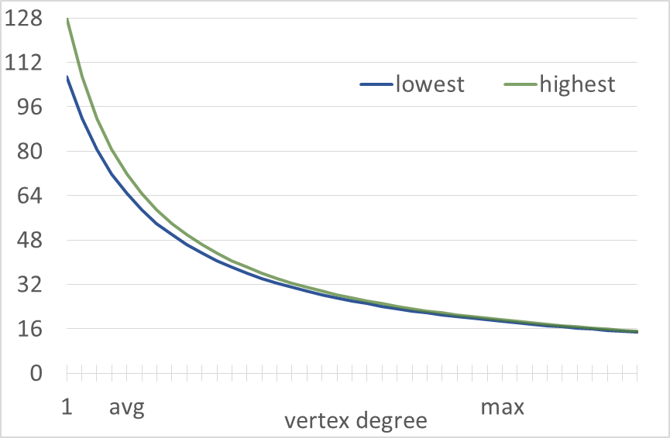
Permutation-Selection Function
Wide range at low degrees
50% of range is below avg degree
Makes ties unlikely
Narrow range at high degrees
Ties are likely but unimportant

Slide 52
Combining Information
Standard implementation (2 arrays)
1st array: vertex state (undecided, in set, out of set)
2nd array: vertex priority (random number)
Our implementation (1 array)
7 MSBs hold combined status and priority
Reserved highest value: in set (= higher than its neighbors)
Reserved lowest value: out of set (= removed from graph)
Remaining values = priority
LSB = decided/undecided (to boost performance)
in
prio
prio
.
.
.
prio
prio
out

Slide 53
Results

Slide 54
Methodology
System
GPUs: Titan X and K40, nvcc 8.0
CPUs: 2 Xeon E5-2687W v3 (20 cores, 3.1GHz), gcc 5.3
GPU MIS codes
CUSP, ECL, IrGL, and Pannotia
CPU MIS codes
Ligra, Ligra+, and PBBS (Cilk and OpenMP, incremental and non-deterministic)
PBBS (serial)

Slide 55
Input Graphs
16 graphs
Real-world + synth.
All made undirected
Sizes
66k – 24M vertices
387k – 524M edges
0 – 214k degrees

Slide 56
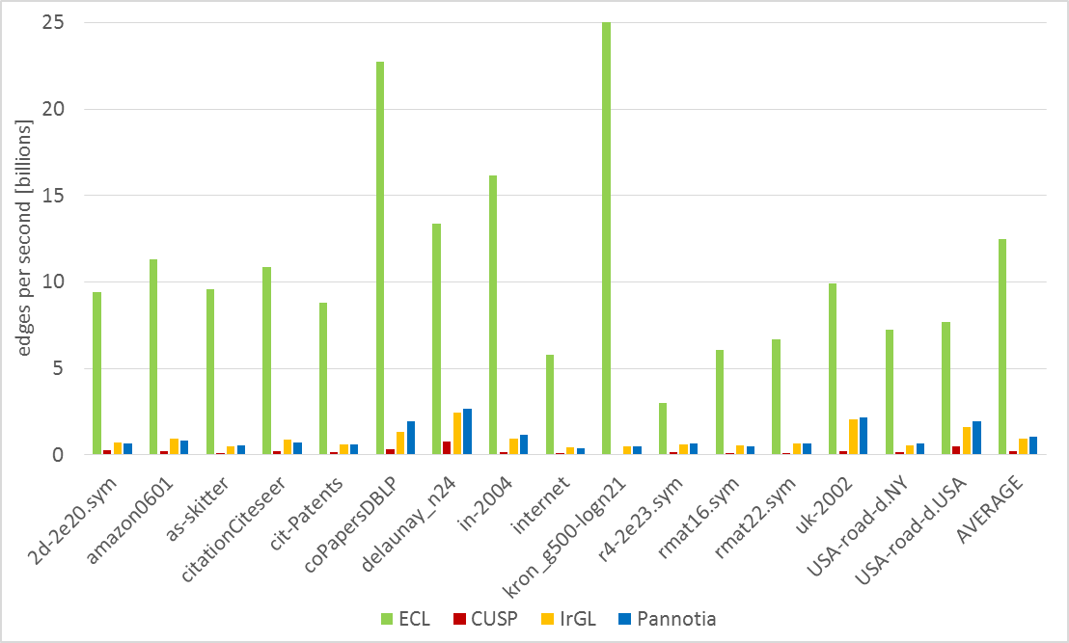
Titan X Performance (Edges/Second)
>100x faster than other codes on kron
ECL-MIS is >3.9x faster on each tested graph
>12x faster than other codes on average

Slide 57
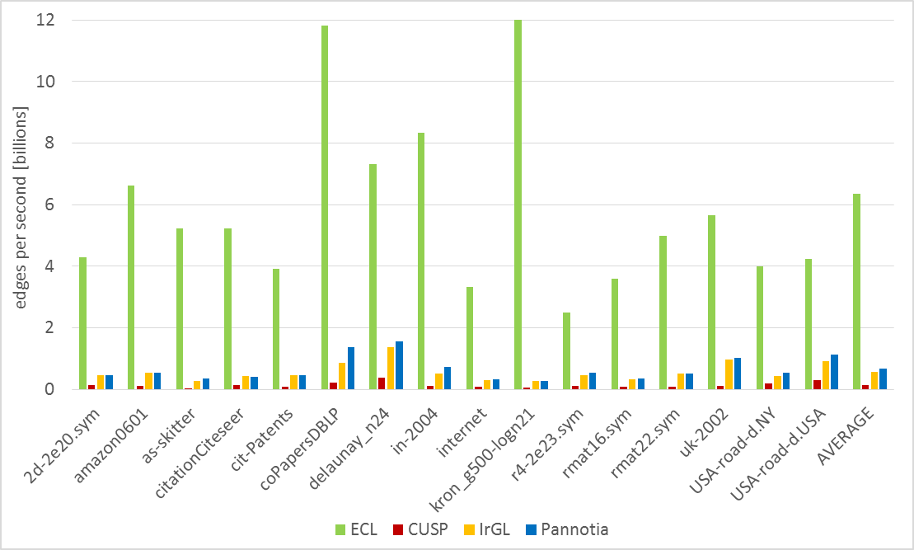
K40 Performance (Edges/Second)
>70x faster than other codes on kron
ECL-MIS is >3.8x faster on each tested graph
>9x faster than other codes on average

Slide 58
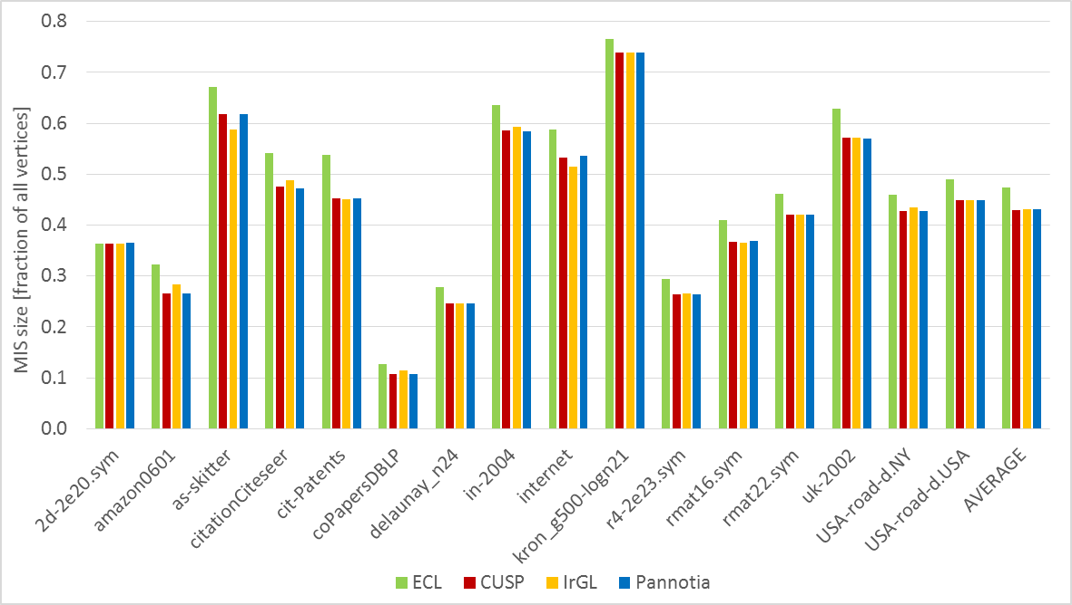
Set Size (Deterministic)
ECL-MIS yields largest set on all but one graph
10% larger on average

Slide 59
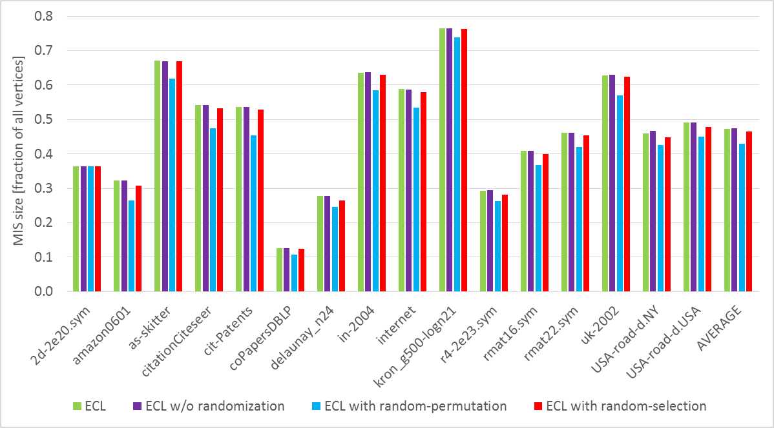
Set Size with Different Approaches
Randomization does not affect ECL-MIS set size
Random selection yields 1.7% smaller sets
Random permutation yields 10% smaller sets

Slide 60
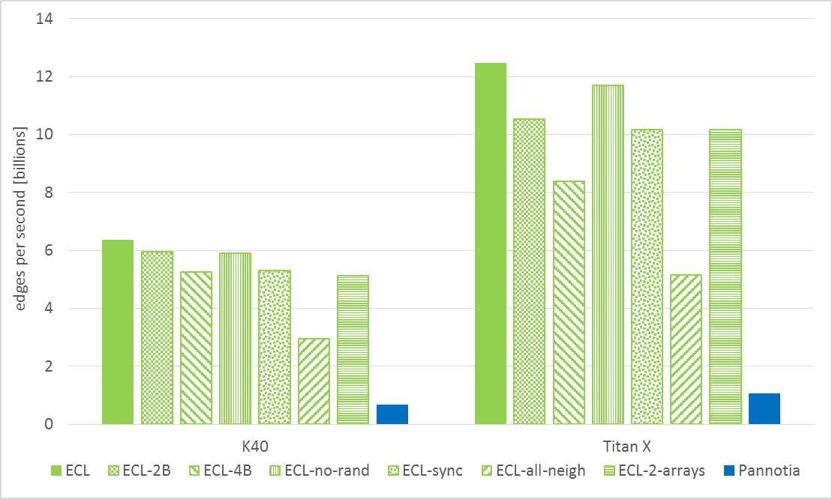
Performance Optimizations
Using 16-bit values yields a 15% slowdown
Synchronous execution yields an 18% slowdown
Using 32-bit values yields a 33% slowdown
Using 2 separate arrays yields an 18% slowdown
Not using randomization yields a 6% slowdown
Combination of optimizations is key
Combination of optimizations is key
Visiting all neighbors yields a 59% slowdown

Slide 61
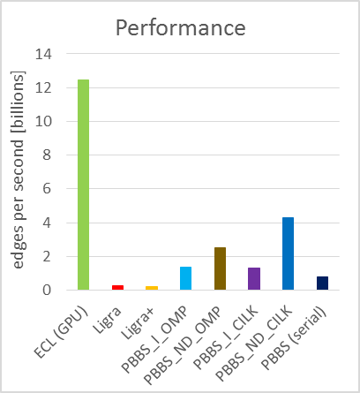
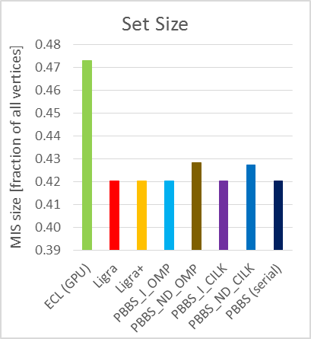
Comparison to CPU Codes (Averages)
9% to 11% larger on average
>2.9x faster than CPU codes on average
ECL-MIS yields largest set on 15 of 16 graphs
ECL-MIS is fastest on all but one tested graph

Slide 62
Summary
ECL-MIS maximal independent set algorithm
Fastest GPU implementation (due to optimizations)
Produces largest sets (due to permutation selection)
Atomic-free CUDA implementation
http://cs.txstate.edu/~burtscher/research/ECL-MIS/
Acknowledgments
NSF grant 1406304
Nvidia donations

